Slide 1
quiz
activity

Slide 2
Question 1
Who is God’s son?

Slide 3
Question 2
What happened on the 4th day of creation?

Slide 4
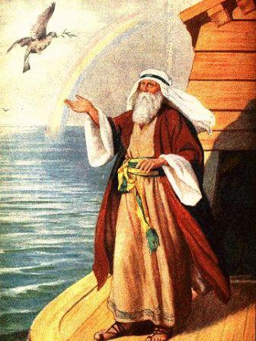
Question 3
Who am I?

Slide 5
Question 4
What did John the Baptist wear clothing made out of?

Slide 6
Question 5
Who was the oldest person in the Bible?

Slide 7
Question 6
Where did Jesus turn water into wine?

Slide 8
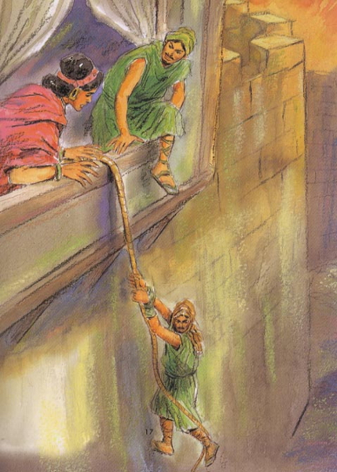
Question 7
Who am I?
(the lady in the picture)

Slide 9
Question 8
What was Esther’s Hebrew name?

Slide 10
Question 9
Where did the wise man build his house?

Slide 11
Question 10
How long did the children of Israel have to wander in the wilderness for?

Slide 12
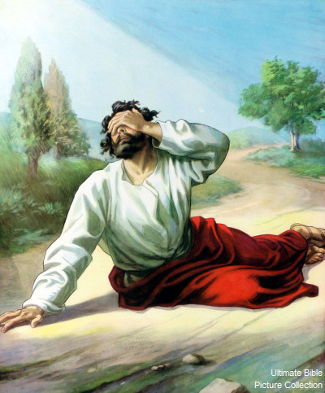
Question 11
Who am I?

Slide 13
Question 12
How many tribes of Israel were there?

Slide 14
Question 13
How many books are in the Bible?

Slide 15
Question 14
Who had a donkey that spoke to him?

Slide 16
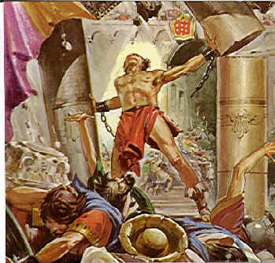
Question 15
Who am I?

Slide 17
Question 16
What was Judas given by the Jewish authorities to betray Jesus?

Slide 18
Question 17
Who was the youngest king to reign in the Bible?

Slide 19
Question 18
Who was swallowed by a big fish?

Slide 20
Question 19
What were the Chaldean names for Hananiah, Mishael, Azariah?

Slide 21
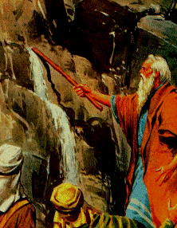
Question 20
Who am I?

Slide 22
ANSWERS

Slide 23
Question 1
Who is God’s son?
Answer: Jesus

Slide 24
Question 2
What happened on the 4th day of creation?
Answer: God appointed the sun, moon and stars (Genesis 1v14-19)

Slide 25
Question 3
Who am I?
Answer: Noah

Slide 26
Question 4
What did John the Baptist wear clothing made out of?
Answer: Camel’s hair (Matthew 3v4)

Slide 27
Question 5
Who was the oldest person in the Bible?
Answer: Methuselah (Genesis 5v27)

Slide 28
Question 6
Where did Jesus turn water into wine?
Answer: Cana (John 2v1)

Slide 29
Question 7
Who am I?
(the lady in the picture)
Answer: Rahab

Slide 30
Question 8
What was Esther’s Hebrew name?
Answer: Hadassah (Esther 2v7)

Slide 31
Question 9
Where did the wise man build his house?
Answer: On a rock (Matthew 7v24)

Slide 32
Question 10
How long did the children of Israel have to wander in the wilderness for?
Answer: 40 years (Numbers 32v13)

Slide 33
Question 11
Who am I?
Answer: Paul

Slide 34
Question 12
How many tribes of Israel were there?
Answer: 12 (Genesis 49v28)

Slide 35
Question 13
How many books are in the Bible?
Answer: 66

Slide 36
Question 14
Who had a donkey that spoke to him?
Answer: Balaam (Numbers 22v28)

Slide 37
Question 15
Who am I?
Answer: Samson

Slide 38
Question 16
What was Judas given by the Jewish authorities to betray Jesus?
Answer: 30 pieces of silver (Matthew 26v15)

Slide 39
Question 17
Who was the youngest king to reign in the Bible?
Answer: Joash – only 7 years old (2 Chronicles 24v1)

Slide 40
Question 18
Who was swallowed by a big fish?
Answer: Jonah (Jonah 1v17)

Slide 41
Question 19
What were the Chaldean names for Hananiah, Mishael, Azariah?
Answer: Shadrach, Meshach and Abednego (Daniel 1v7)

Slide 42
Question 20
Who am I?
Answer: Moses

Slide 43
The End ☺

