Slide 1
QUIZ AFTERNOON
Family Day Activity

Slide 2
Quiz Rounds and Activities
Round 1 Finish the Proverb (5 proverbs)
Round 2 Pictionary x 4
Activity: Balloon burst (for children)
Round 3 Who Am I? (10 people)
Round 4 Label the parts of the Spiritual Warrior (Ephesians 6)
Activity: Move the marshmallows (for young children)
Round 5 Bible math (4 questions)
Round 6 Guess the hymn (5 hymns)
Activity: Paper airplanes
Round 7 Geography of Israel (8 places)
Round 8 Bible oddities (10 questions)
Activity: The most push ups

Slide 3
ROUND 1
Finish the Proverb

Slide 4
Proverb 1
He that covereth a transgression seeketh love; but he that repeateth a matter…

Slide 5
Proverb 2
A reproof entereth more into a wise man than an…

Slide 6
Proverb 3
A friend loveth at all times,
and a …

Slide 7
Proverb 4
A merry heart doeth good …

Slide 8
Proverb 5
Even a fool,
when he holdeth his peace…

Slide 9
ANSWERS

Slide 10
Proverb 1
He that covereth a transgression seeketh love; but he that repeateth a matter…
Answer: …separateth very friends (Prov 17v9)

Slide 11
Proverb 2
A reproof entereth more into a wise man than an…
Answer: …hundred stripes into a fool (Prov 17v10)

Slide 12
Proverb 3
A friend loveth at all times,
and a …
Answer: …brother is born for adversity (Prov 17v17)

Slide 13
Proverb 4
A merry heart doeth good …
Answer: …like a medicine
(Prov 17v22)

Slide 14
Proverb 5
Even a fool,
when he holdeth his peace…
Answer: …is counted wise
(Prov 17v28)

Slide 15
ROUND 2
Pictionary

Slide 16
Drawing 1
Hint: Mt Sinai
Answer: Moses holding two tables of stones with the 10 commandments on them.

Slide 17
Drawing 2
Hint: Needle and thread
Answer: Paul sewing tents with Aquila and Priscilla.

Slide 18
Drawing 3
Hint: A huge change in life!
Answer: Nebuchadnezzar turns into a beast and lives like an animal.

Slide 19
Drawing 4
Hint: Into the Promised Land
Answer: The walls of Jericho falling down.

Slide 20
ACTIVITY
Balloon Burst

Slide 21
ROUND 3
Who am I?

Slide 22
Question 1
I was the first man on earth.

Slide 23
Question 2
I was a seller of purple.

Slide 24
Question 3
I was the commander of the Syrian Army and I had leprosy.

Slide 25
Question 4
I was an apostle who was exiled to Patmos.

Slide 26
Question 5
I stirred up the people to rebuild the walls of Jerusalem.

Slide 27
Question 6
I performed a miracle where an axe head floated.

Slide 28
Question 7
It took me 13 years to build my palace.

Slide 29
Question 8
I fell out of a window while I was listening to Paul preach.

Slide 30
Question 9
I lead 300 men against the Midianite armies.

Slide 31
Question 10
I anointed Solomon as king.

Slide 32
ANSWERS

Slide 33
Question 1
I was the first man on earth.
Answer: Adam

Slide 34
Question 2
I was a seller of purple.
Answer: Lydia (Acts 16v14)

Slide 35
Question 3
I was the commander of the Syrian Army and I had leprosy.
Answer: Naaman (2 Kings 5v1)

Slide 36
Question 4
I was an apostle who was exiled to Patmos.
Answer: John (Rev 1v9)

Slide 37
Question 5
I stirred up the people to rebuild the walls of Jerusalem.
Answer: Nehemiah (Neh 2v18)

Slide 38
Question 6
I performed a miracle where an axe head floated.
Answer: Elisha (2 Kings 6v1-7)

Slide 39
Question 7
It took me 13 years to build my palace.
Answer: Solomon (1 Kings 7v1)

Slide 40
Question 8
I fell out of a window while I was listening to Paul preach.
Answer: Eutychus (Acts 20v9)

Slide 41
Question 9
I lead 300 men against the Midianite armies.
Answer: Gideon (Judges 7v6-7)

Slide 42
Question 10
I anointed Solomon as king.
Answer: Zadok (1 Kings 1v39)

Slide 43
ROUND 4
Spiritual Warrior

Slide 44
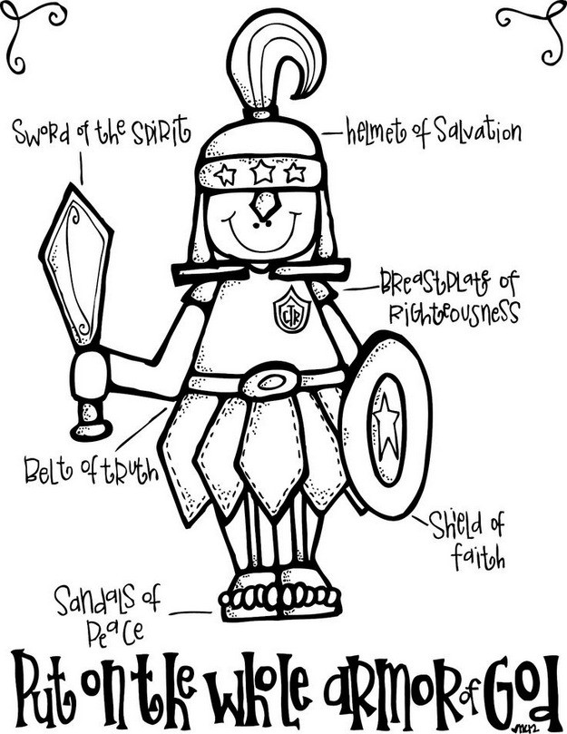

Slide 45
ANSWERS

Slide 47
ACTIVITY
Move the Marshmallows

Slide 48
ROUND 5
Bible Math

Slide 49
Click on circle to start timer
End
1
2
3
4
5
6
7
8
9
10
11
12
13
14
15
16
17
18
19
20
21
22
23
24
25
26
27
28
29
30
31
32
33
34
35
36
37
38
39
40
41
42
43
44
45
46
47
48
49
50
51
52
53
54
55
56
57
58
59
60
Question 1 – For Kids
Take the number of disciples Jesus had.
Add the number of wise virgins.
Subtract the day that God made dry land appear.
Add the number of years Jacob agreed to serve Laban for so he could marry Rachel.
Add the number of plagues God sent on Egypt.

Slide 50
Click on circle to start timer
End
1
2
3
4
5
6
7
8
9
10
11
12
13
14
15
16
17
18
19
20
21
22
23
24
25
26
27
28
29
30
31
32
33
34
35
36
37
38
39
40
41
42
43
44
45
46
47
48
49
50
51
52
53
54
55
56
57
58
59
60
Question 2
Take the number of tribes in Israel.
Add the number of days Jesus fasted in the wilderness.
Subtract the number of days it took to rebuild the walls of Jerusalem in Nehemiah’s day.
Add the number of days Jesus spent with his disciples after he was resurrected.
Divide by the number of wagons given to the sons of Merari in Numbers 7v8.

Slide 51
Click on circle to start timer
End
1
2
3
4
5
6
7
8
9
10
11
12
13
14
15
16
17
18
19
20
21
22
23
24
25
26
27
28
29
30
31
32
33
34
35
36
37
38
39
40
41
42
43
44
45
46
47
48
49
50
51
52
53
54
55
56
57
58
59
60
Question 3
Take the number of chapters in Ezra.
Multiply by the number of months Moses was hidden by his parents when he was born.
Add the number of fish Peter caught in John 21.
Subtract the number of books in the Bible.
Add the age Josiah was when he became king.

Slide 52
Click on circle to start timer
End
1
2
3
4
5
6
7
8
9
10
11
12
13
14
15
16
17
18
19
20
21
22
23
24
25
26
27
28
29
30
31
32
33
34
35
36
37
38
39
40
41
42
43
44
45
46
47
48
49
50
51
52
53
54
55
56
57
58
59
60
Question 4
Take the number of pieces of silver Joseph was sold for.
Multiply by the number of times Naaman dipped himself in the River Jordan.
Add the number of years that David reigned for.
Divide by the number of things mentioned in Proverbs that are little upon earth, but exceeding wise.
Subtract the number of maidens that Hegai gave to Esther.

Slide 53
ANSWERS

Slide 54
Question 1 – For Kids
Take the number of disciples Jesus had (12 – Matt 10v1)
Add the number of wise virgins (5 – Matt 25v2)
Subtract the day that God made dry land appear (3 – Gen 1v9)
Add the number of years Jacob agreed to serve Laban for so he could marry Rachel (7 – Gen 29v18)
Add the number of plagues God sent on Egypt (10)
Answer: 12 + 5 – 3 + 7 + 10 = 31

Slide 55
Question 2
Take the number of tribes in Israel (12 – Gen 49v28)
Add the number of days Jesus fasted in the wilderness (40 – Matt 4v2)
Subtract the number of days it took to rebuild the walls of Jerusalem in Nehemiah’s day (52 – Neh 6v15)
Add the number of days Jesus spent with his disciples after he was resurrected (40 – Acts 1v3)
Divide by the number of wagons given to the sons of Merari in Numbers 7v8 (4)
Answer: 12 + 40 – 52 + 40 / 4 = 10

Slide 56
Question 3
Take the number of chapters in Ezra (10)
Multiply by the number of months Moses was hidden by his parents when he was born (3 – Heb 11v3)
Add the number of fish Peter caught in John 21 (153 – John 21v11)
Subtract the number of books in the Bible (66)
Add the age Josiah was when he became king (8 – 2 Kings 22v1)
Answer: 10 x 3 + 153 - 66 + 8 = 125

Slide 57
Question 4
Take the number of pieces of silver Joseph was sold for (20 – Gen 37v28)
Multiply by the number of times Naaman dipped himself in the river Jordan (7 – 2 Kings 5v14)
Add the number of years that David reigned for (40 – 1 Kings 2v11)
Divide by the number of things mentioned in Proverbs that are little upon earth, but exceeding wise (4 – Prov 30v25)
Subtract the number of maidens that Hegai gave to Esther (7 – Est 2v9)
Answer: 20 x 7 + 40 / 4 - 7 = 38

Slide 58
ROUND 6
Guess the Hymn

Slide 59
ANSWERS

Slide 60
Hymn 379 – Most glorious things
Hymn 14 – God is my strong salvation
Hymn 135 – Dear Lord and maker
Hymn 410 – Lord keep us safe
Hymn 77 – All-pow’rful, self-existent God

Slide 61
ACTIVITY
Paper Airplanes

Slide 62
ROUND 7
Geography of Israel

Slide 63
ANSWERS

Slide 64
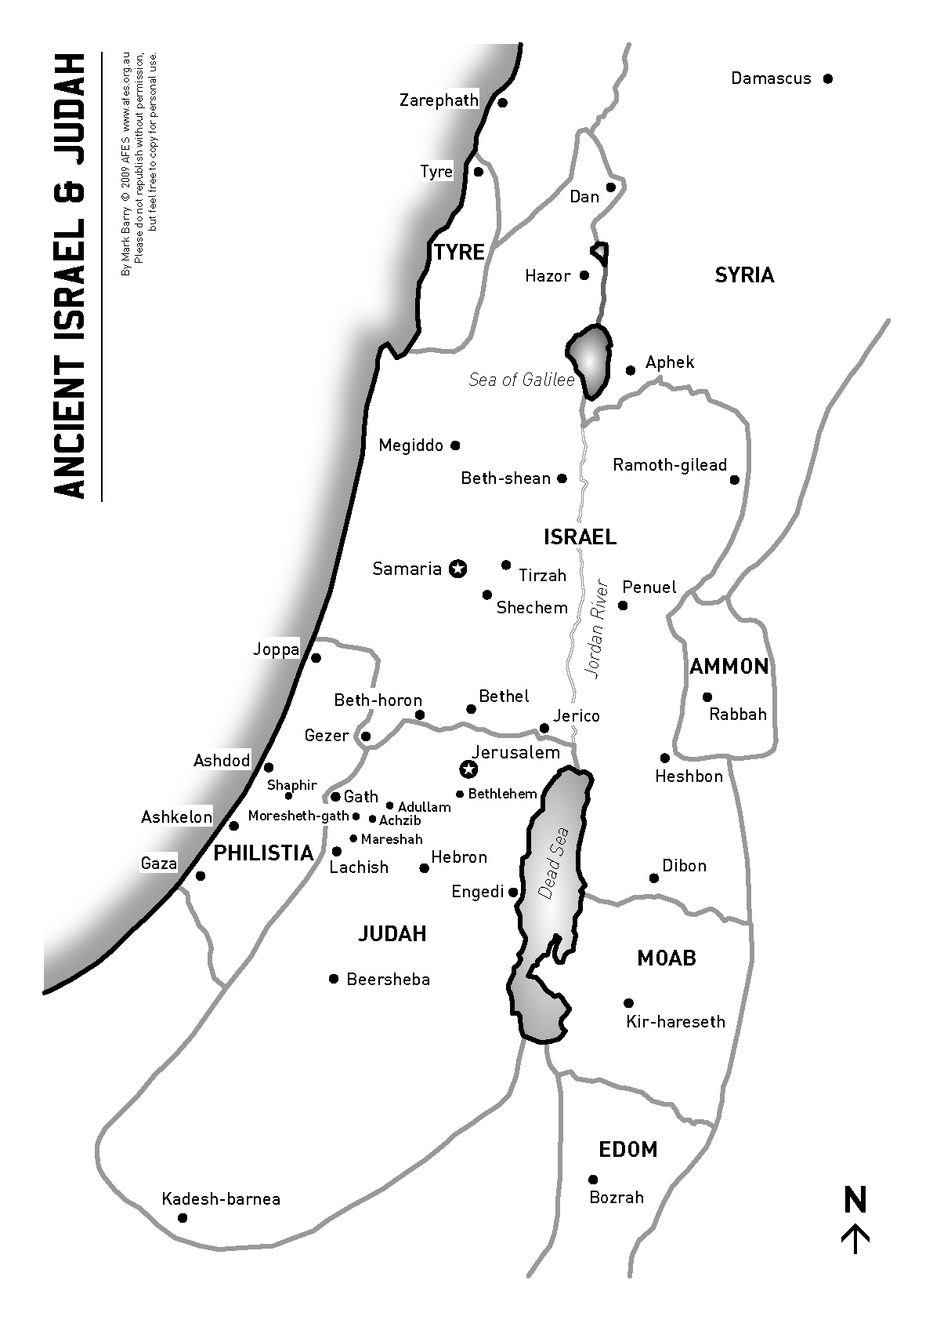
Jerusalem | 1
Bethlehem | 4
Shechem | 8
Damascus | 6
Kadesh-barnea | 3
Jericho | 5
Joppa | 2
Beersheba | 7

Slide 65
ROUND 8
Bible Oddities

Slide 66
Question 1
Who wore camel’s hair for his clothes?

Slide 67
Question 2
How many books in the Bible are named after women?

Slide 68
Question 3
What is the only book of the Bible to mention a “pair of shoes”?

Slide 69
Question 4
What is the chapter that talks about dead, dry bones being brought to life.

Slide 70
Question 5
What is the longest name in the Bible?

Slide 71
Question 6
Who was the first man recorded of shaving?

Slide 72
Question 7
Who used a stone for a pillow?

Slide 73
Question 8
Who died by having a wet thick cloth put on his face?

Slide 74
Question 9
What did Shamgar slay 600 Philistines with.

Slide 75
Question 10
Who cut Samson’s hair?

Slide 76
ANSWERS

Slide 77
Question 1
Who wore camel’s hair for his clothes?
Answer: John the Baptist (Mark 1v6)

Slide 78
Question 2
How many books in the Bible are named after women?
Answer: Two – Esther, Ruth

Slide 79
Question 3
What is the only book of the Bible to mention a “pair of shoes”?
Answer: Amos (Amos 2v6, 8v6)

Slide 80
Question 4
What is the chapter that talks about dead, dry bones being brought to life.
Answer: Ezekiel 37

Slide 81
Question 5
What is the longest name in the Bible?
Answer: Mahershalalhashbaz (Isa 8v1)

Slide 82
Question 6
Who was the first man recorded of shaving?
Answer: Joseph (Gen 41v14)

Slide 83
Question 7
Who used a stone for a pillow?
Answer: Jacob (Gen 28v11)

Slide 84
Question 8
Who died by having a wet thick cloth put on his face?
Answer: Benhadad (2 Kings 8v7, 15)

Slide 85
Question 9
What did Shamgar slay 600 Philistines with.
Answer: An ox goad (Jud 3v31)

Slide 86
Question 10
Who cut Samson’s hair?
Answer: “A man” (Jud 16v19)

Slide 87
ACTIVITY
Push Ups

Slide 88
Thanks for participating!
☺

