Slide 1
Song & Praise Evening THEME: PRAYER

Slide 2
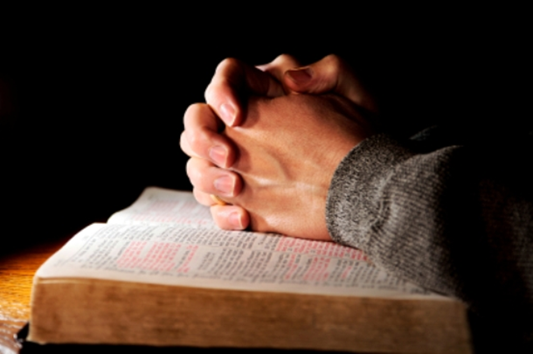
Rejoice in hope, Be patient in tribulation, Be constant in prayer. Romans 12:12

Slide 3
PRAYER
Lord, Teach Us To Pray
Prayers In Personal Trials & For Others
Prayers For Forgiveness
Thanksgiving For Our Hope in Christ
Supplication For The Coming Kingdom

Slide 4
PRAYER - Opening
Opening Reading: I Kings 8:22-30, 38-40
Opening Hymn 153 (green book, please stand)
“Lord, when we meet to worship thee”
Opening Prayer

Slide 5
1. Lord, Teach Us To Pray
Scripture Readings:
Luke 11:1; Matthew 6:5-15
Poem: “Safe and True” (Sister Marguerite Curry)
Hymn 161 (green book, remain seated)
“Our Father which art in heaven”

Slide 6
2. Prayers in Personal Trials & For Others
Scripture Readings: Psalm 5:1-3; Psalm 42
Hymn 155 (please remain seated)
“Lord, who Thyself has bidden us to pray”
Scripture Readings: Psalm 40; James 5:13-20
Hymn 136 (please stand)
“Father, hear the prayer we offer”

Slide 7
3. Prayers For Forgiveness
Poem (Author: J. Morse)
Scripture Reading: Psalm 51
Hymn 152 (green book, remain seated)
“Lord, when we bend before thy throne”
Prayer for those in trials & for forgiveness (remain seated)
Meditational Hymn, “Pray One For Another”, written by Bro. Dan Osborn (please listen)

Slide 8
Meditational Hymn: Pray One For Another (Dan Osborn)
Confess your faults, one to another, and pray one for another
That ye may be healed, that ye may be healed.
Confess your faults, one to another, and pray one for another
That ye may be healed, that ye may be healed.
The effectual fervent prayer of a righteous man availeth much.
The effectual fervent prayer of a righteous man availeth much.
Confess your faults one to another,
And pray one for another.

Slide 9
4. Thanksgiving For Our Hope In Christ
Poem: “The Saviour’s Plea” (Sister Marguerite Curry)
Scripture Reading: Romans 5:1-11
Song of Praise, “Lord of all we give you glory”
(please stand, music on chairs
and words displayed on the screen)

Slide 10
Lord Of All (Sister Sharon Carroll)
Lord of all we give you glory
For the wondrous things you’ve done;
Bringing hope and our salvation,
Through the offering of your Son.
For we’re called to be Christ’s brethren,
And we’re called to be your sons,
If we give you our obedience,
Serving you alone in love.

Slide 11
When our faith is weak and failing,
Trials and burdens hard to bear;
You’re the strong One who can save us,
If we turn to you in prayer.
You’re the Rock that’s true and faithful,
On your Word we can depend;
For you’ve given this assurance
Raising Jesus from the dead.

Slide 12
How long Heavenly Father,
Till we see your Son?
Hasten the day when we all shall be as one.
Lord of all we give you glory,
We will praise your Name on high
You’re the Rock of our salvation,
Who has bought us with a price.

Slide 13
We’ll press onward, ever onward
To receive the glorious prize
Following our master’s footsteps,
Leading to eternal life.
For this world can offer nothing,
To compare to this great prize,
So let’s run the race with patience
To obtain a crown of life.

Slide 14
Help us keep ourselves from idols,
True to God our hearts remain
And what e’er we do, in all things,
May we glorify your name.

Slide 15
5. Supplication For The Coming Kingdom
Poem: “Thy Kingdom Come”
(Sister Marguerite Curry)
Scripture Reading: Isaiah 35:1-10
Closing Hymn 266 (please stand)
“Lord we wait the time of blessing”
Closing Prayer

