Slide 5
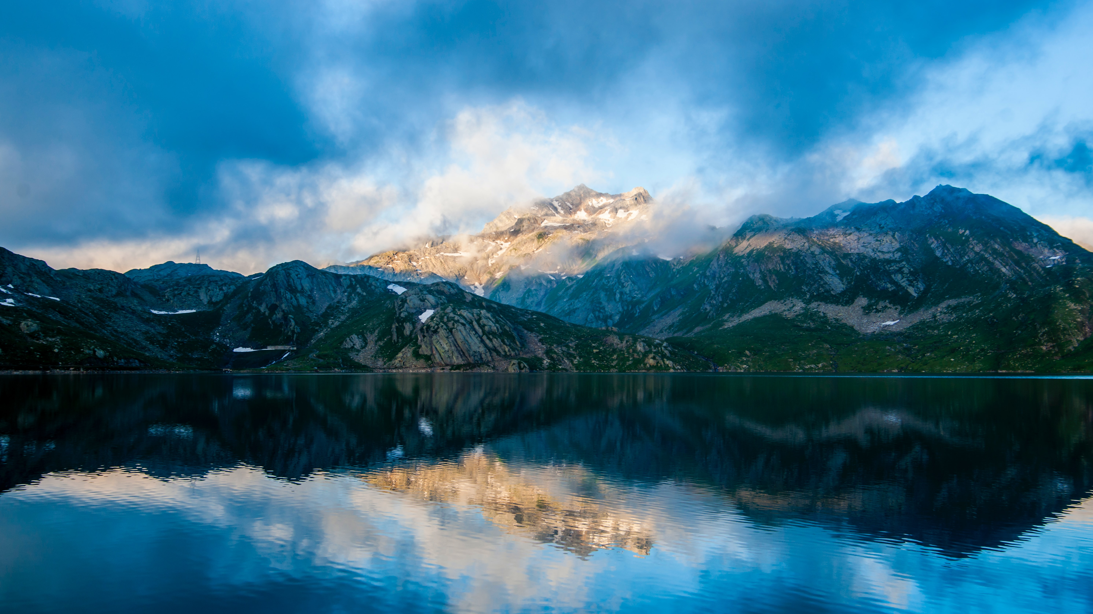
Psalm 100
¹ Make a joyful noise unto the Lord, all ye lands.
² Serve the Lord with gladness: come before his presence with singing.
³ Know ye that the Lord he is God: it is he that hath made us, and not we ourselves; we are his people, and the sheep of his pasture.
⁴ Enter into his gates with thanksgiving, and into his courts with praise: be thankful unto him, and bless his name.
⁵ For the Lord is good; his mercy is everlasting; and his truth endureth to all generations.

Slide 6
Hymn 50
All people that on earth do dwell, Sing to the Lord with cheerful voice; Him serve with joy, His praise forth tell, Come ye before Him and rejoice. Know that the Lord is God indeed, Without our aid He did us make: We are His flock, He doth us feed, And for His sheep He doth us take. O enter then His gates with praise, Approach with thanks His courts unto: Praise, laud, and bless His name always, For it is seemly so to do. For why? the Lord our God is good, His mercy is for ever sure; His truth at all times firmly stood, And shall from age to age endure.

Slide 7
Psalm 145:1-10
¹ I will extol thee, my God, O king; and I will bless thy name for ever and ever.
² Every day will I bless thee; and I will praise thy name for ever and ever.
³ Great is the Lord, and greatly to be praised; and his greatness is unsearchable.
⁴ One generation shall praise thy works to another, and shall declare thy mighty acts.
⁵ I will speak of the glorious honour of thy majesty, and of thy wondrous works.
⁶ And men shall speak of the might of thy terrible acts: and I will declare thy greatness.
⁷ They shall abundantly utter the memory of thy great goodness, and shall sing of thy righteousness.
⁸ The Lord is gracious, and full of compassion; slow to anger, and of great mercy.
⁹ The Lord is good to all: and his tender mercies are over all his works.
¹⁰ All thy works shall praise thee, O Lord; and thy saints shall bless thee.

Slide 8
Hymn 68
I will extol Thee, my God, O King, And I will bless Thy name for ever and ever. Ev'ry day I will bless Thee, And I will praise Thy name for ever and ever. Great is the Lord, and greatly to be praised, And His greatness is unsearchable.

Slide 9
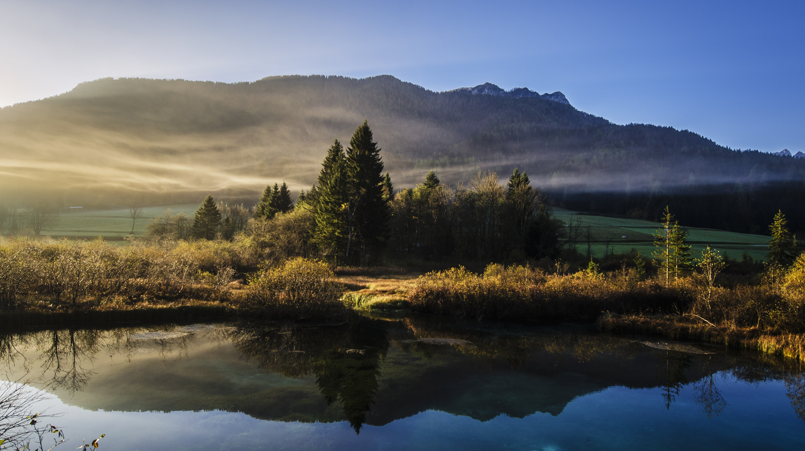
Psalm 34:1-9
¹ I will bless the Lord at all times: his praise shall continually be in my mouth.
² My soul shall make her boast in the Lord: the humble shall hear thereof, and be glad.
³ O magnify the Lord with me, and let us exalt his name together.
⁴ I sought the Lord, and he heard me, and delivered me from all my fears.
⁵ They looked unto him, and were lightened: and their faces were not ashamed.
⁶ This poor man cried, and the Lord heard him, and saved him out of all his troubles.
⁷ The angel of the Lord encampeth round about them that fear him, and delivereth them.
⁸ O taste and see that the Lord is good: blessed is the man that trusteth in him.
⁹ O fear the Lord, ye his saints: for there is no want to them that fear him.

Slide 10
Hymn 95
Infinite God, to Thee our voice we raise, And with our voice our heart in song of praise: By all Thy works adored, We worship Thee, the Lord; Receive our homage, God of endless days. To Thee the angels and archangels sing; Of every lord the Lord, of kings the King; King of the saints of old, Lord of a glorious fold, Thine is the tribute which the angels bring. So with angelic song shall ours unite - Children of faith in hope of life and light - Glory to God above, Praise to the God of love; Let heaven and earth acclaim with all their might.

Slide 11
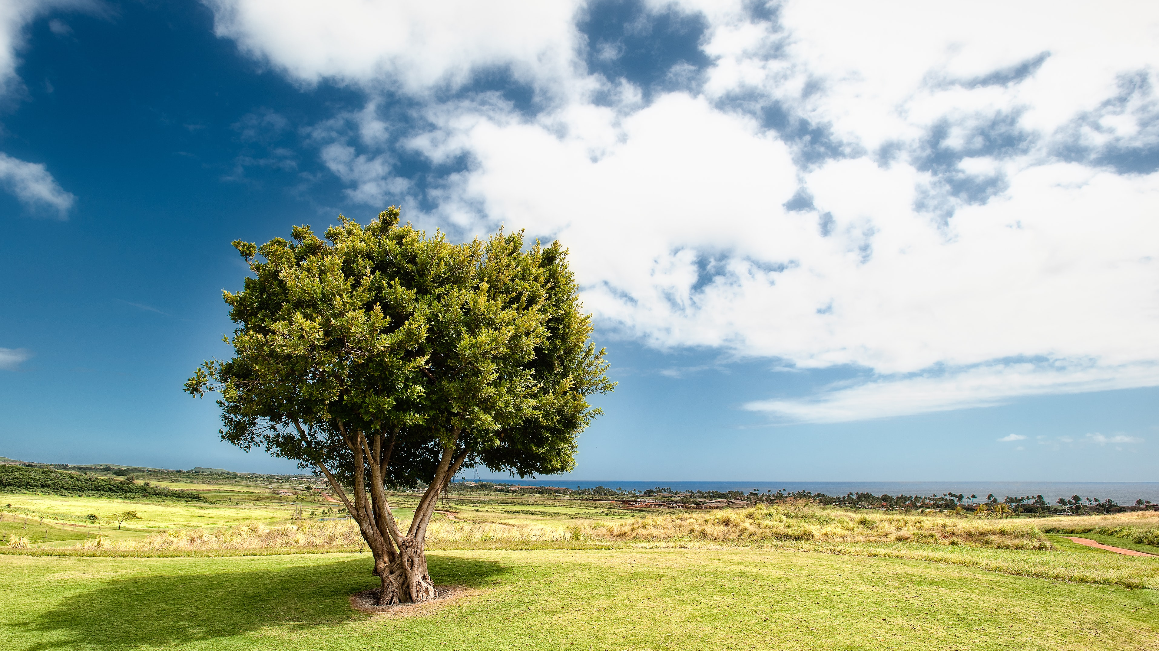
Psalm 92:1-5, 12-15
¹ It is a good thing to give thanks unto the Lord, and to sing praises unto thy name, O Most High:
² To shew forth thy lovingkindness in the morning, and thy faithfulness every night,
³ Upon an instrument of ten strings, and upon the psaltery; upon the harp with a solemn sound.
⁴ For thou, Lord, hast made me glad through thy work: I will triumph in the works of thy hands.
⁵ O Lord, how great are thy works! and thy thoughts are very deep.
¹² The righteous shall flourish like the palm tree: he shall grow like a cedar in Lebanon.
¹³ Those that be planted in the house of the Lord shall flourish in the courts of our God.
¹⁴ They shall still bring forth fruit in old age; they shall be fat and flourishing;
¹⁵ To shew that the Lord is upright: he is my rock, and there is no unrighteousness in him.

Slide 12
Hymn 99
Lift up to God the voice of praise, Swell high your grateful song; Loud and more loud the anthem raise, Loud and more loud the anthem raise, Your notes of joy prolong. Lift up to God the voice of praise; Extol and bless His Name - Who gives you life and length of days Who gives you life and length of days His mercies to proclaim. Lift up to God the voice of praise, Whose goodness, passing thought, Loads every minute, as it flies, Loads every minute, as it flies, With benefits unsought. Lift up to God the voice of praise For His revealed word: His will and purpose, and His ways, His will and purpose, and His ways, They all are in accord.
Lift up to God the voice of praise For His dear Son, our Lord; And for the hope of endless days, And for the hope of endless days, As promised in His word.

Slide 13
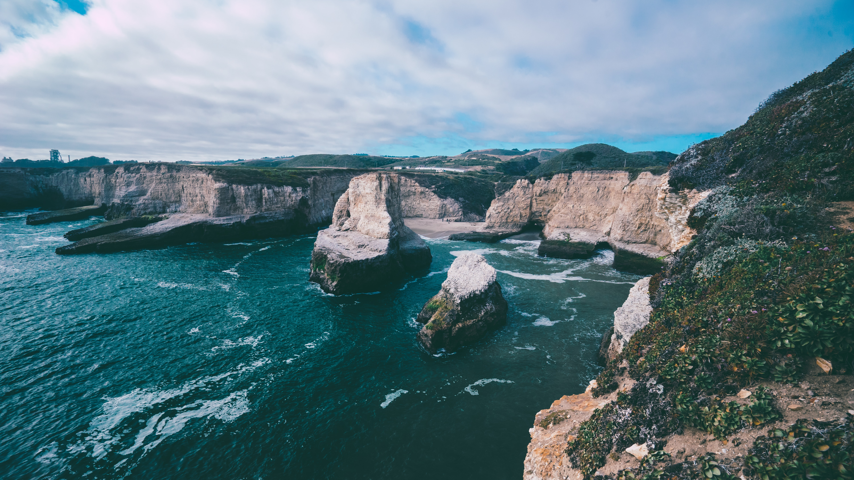
Psalm 111
¹ Praise ye the Lord. I will praise the Lord with my whole heart, in the assembly of the upright, and in the congregation.
² The works of the Lord are great, sought out of all them that have pleasure therein.
³ His work is honourable and glorious: and his righteousness endureth for ever.
⁴ He hath made his wonderful works to be remembered: the Lord is gracious and full of compassion.
⁵ He hath given meat unto them that fear him: he will ever be mindful of his covenant.
⁶ He hath shewed his people the power of his works, that he may give them the heritage of the heathen.
⁷ The works of his hands are verity and judgment; all his commandments are sure.
⁸ They stand fast for ever and ever, and are done in truth and uprightness.
⁹ He sent redemption unto his people: he hath commanded his covenant for ever: holy and reverend is his name.
¹⁰ The fear of the Lord is the beginning of wisdom: a good understanding have all they that do his commandments: his praise endureth for ever.

Slide 14
Hymn 102
My God, how wonderful Thou art, Thy majesty how bright! How beautiful Thy Mercy-Seat That shines with healing light! How wonderful, how beautiful, The sight of Thee must be, Thine endless wisdom, boundless power, And aweful purity! O, how I fear Thee, living God, With deepest, tenderest fears, And worship Thee with trembling hope, And penitential tears! Yet I may love Thee too, O Lord, Almighty as Thou art, For Thou hast stooped to ask of me The love of my poor heart.
My God, how wonderful Thou art, Thy majesty how bright! How beautiful Thy Mercy-Seat That shines with healing light!

Slide 15
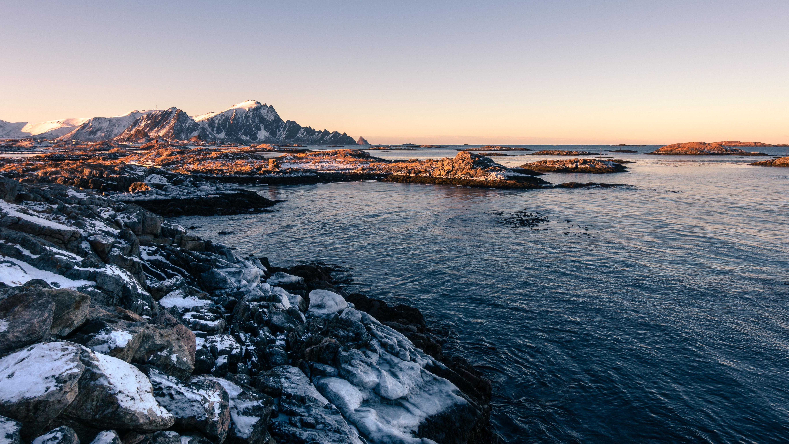
Psalm 50:1-6
¹ The mighty God, even the Lord, hath spoken, and called the earth from the rising of the sun unto the going down thereof.
² Out of Zion, the perfection of beauty, God hath shined.
³ Our God shall come, and shall not keep silence: a fire shall devour before him, and it shall be very tempestuous round about him.
⁴ He shall call to the heavens from above, and to the earth, that he may judge his people.
⁵ Gather my saints together unto me; those that have made a covenant with me by sacrifice.
⁶ And the heavens shall declare his righteousness: for God is judge himself. Selah.

Slide 16
Hymn 107
O give thanks to Him who made Morning light and evening shade; Source and Giver of all good,
Nightly sleep and daily food; Quick'ner of our wearied powers, Guard of our unconscious hours. O give thanks to Nature's King, Who made every breathing thing; His our warm and sentient frame, His the mind's exultant flame. Oh, how close the ties that bind All things to th'eternal mind! O give thanks with heart and lip, For we are His workmanship: And all creatures are His care - Not a bird that cleaves the air Falls unnoticed: but who can Speak the Father's love to man?

Slide 17
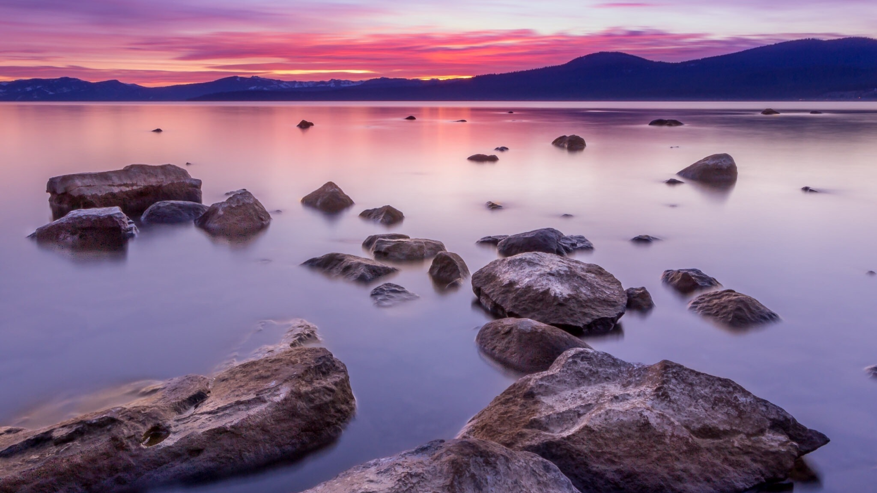
Psalm 189:1-11
¹ I will sing of the mercies of the Lord for ever: with my mouth will I make known thy faithfulness to all generations.
² For I have said, Mercy shall be built up for ever: thy faithfulness shalt thou establish in the very heavens.
³ I have made a covenant with my chosen, I have sworn unto David my servant,
⁴ Thy seed will I establish for ever, and build up thy throne to all generations. Selah.
⁵ And the heavens shall praise thy wonders, O Lord: thy faithfulness also in the congregation of the saints.
⁶ For who in the heaven can be compared unto the Lord? who among the sons of the mighty can be likened unto the Lord?
⁷ God is greatly to be feared in the assembly of the saints, and to be had in reverence of all them that are about him.
⁸ O Lord God of hosts, who is a strong Lord like unto thee? or to thy faithfulness round about thee?
⁹ Thou rulest the raging of the sea: when the waves thereof arise, thou stillest them.
¹⁰ Thou hast broken Rahab in pieces, as one that is slain; thou hast scattered thine enemies with thy strong arm.
¹¹ The heavens are thine, the earth also is thine: as for the world and the fulness thereof, thou hast founded them.

Slide 18
Hymn 113
O worship the King, all glorious above; And gratefully sing His power and His love; Our shield and defender, the ancient of days, Pavilioned in splendour, and girded with praise. O tell of His might, O sing of His grace; Whose robe is the light, whose canopy space. His chariots of wrath the deep thunder-clouds form, And dark is His path on the wings of the storm. This earth, with its store of wonders untold, Almighty, Thy power hath founded of old; Hath stablished it fast by a changeless decree, And round it hath cast, like a mantle, the sea. Thy bountiful care what tongue can recite? It breathes in the air, it shines in the light; It streams from the hills, it descends to the plain, And sweetly distils in the dew and the rain. Frail children of dust, and feeble as frail, In Thee do we trust, nor find Thee to fail; Thy mercies how tender, how firm to the end, Our maker, defender, redeemer and friend. O measureless might, ineffable love, While angels delight to hymn Thee above, Thy humbler creation, though feeble their lays, With true adoration shall sing to Thy praise.

Slide 19
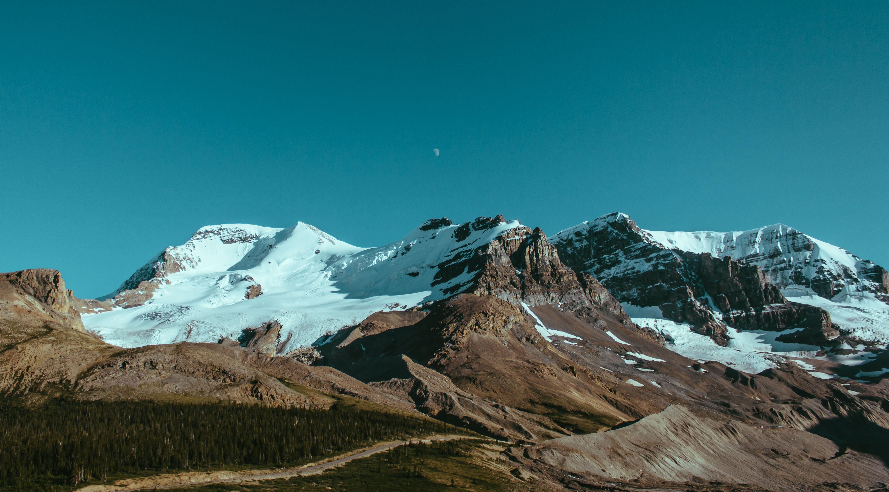
Psalm 95:1-7
¹ O come, let us sing unto the Lord: let us make a joyful noise to the rock of our salvation.
² Let us come before his presence with thanksgiving, and make a joyful noise unto him with psalms.
³ For the Lord is a great God, and a great King above all gods.
⁴ In his hand are the deep places of the earth: the strength of the hills is his also.
⁵ The sea is his, and he made it: and his hands formed the dry land.
⁶ O come, let us worship and bow down: let us kneel before the Lord our maker.
⁷ For he is our God; and we are the people of his pasture, and the sheep of his hand. To day if ye will hear his voice,

Slide 20
Hymn 114
O render thanks to God above, The Fountain of eternal love, Whose mercy firm through ages past Has stood, and shall for ever last. Who can His mighty deeds express - Not only vast, but numberless! What mortal eloquence can raise A tribute equal to His praise! Happy are they, and only they, Who from Thy precepts never stray; Who know the right - nor only so, But seek to practise what they know.

Slide 21
Psalm 150
¹ Praise ye the Lord. Praise God in his sanctuary: praise him in the firmament of his power.
² Praise him for his mighty acts: praise him according to his excellent greatness.
³ Praise him with the sound of the trumpet: praise him with the psaltery and harp.
⁴ Praise him with the timbrel and dance: praise him with stringed instruments and organs.
⁵ Praise him upon the loud cymbals: praise him upon the high sounding cymbals.
⁶ Let every thing that hath breath praise the Lord. Praise ye the Lord.

Slide 22
Hymn 116
Praise, my soul, the King of Heaven, To His feet thy tribute bring; Ransomed, healed, restored, forgiven, Evermore His praises sing; Praise Him, praise Him, praise Him, praise Him, Praise the everlasting King. Praise Him for His grace and favour To our fathers in distress; Praise Him, still the same as ever, Slow to chide and swift to bless; Praise Him, praise Him, praise Him, praise Him, Glorious in His faithfulness. Father-like, He tends and spares us; Well our feeble frame He knows; In His hands He gently bears us, Rescues us from all our foes. Praise Him, praise Him, praise Him, praise Him, Widely as His mercy flows. Angels in your hosts, adore Him; Ye behold Him face to face; Saints triumphant, bow before Him, Gather'd in from ev'ry race; Praise Him, praise Him, praise Him, praise Him, Praise ye all the God of grace.

Slide 24
Psalm 138
¹ I will praise thee with my whole heart: before the gods will I sing praise unto thee.
² I will worship toward thy holy temple, and praise thy name for thy lovingkindness and for thy truth: for thou hast magnified thy word above all thy name.
³ In the day when I cried thou answeredst me, and strengthenedst me with strength in my soul.
⁴ All the kings of the earth shall praise thee, O Lord, when they hear the words of thy mouth.
⁵ Yea, they shall sing in the ways of the Lord: for great is the glory of the Lord.
⁶ Though the Lord be high, yet hath he respect unto the lowly: but the proud he knoweth afar off.
⁷ Though I walk in the midst of trouble, thou wilt revive me: thou shalt stretch forth thine hand against the wrath of mine enemies, and thy right hand shall save me.
⁸ The Lord will perfect that which concerneth me: thy mercy, O Lord, endureth for ever: forsake not the works of thine own hands.

Slide 25
Hymn 89
Hallelujah, God be honoured:
True and righteous all His ways;
Praise our God, all ye that fear Him,
Praise the Lord, His servants, praise.
Come, ye saints, with joy and gladness
For the marriage feast prepare;
Purged from all their sins, the blessed
Robes of righteousness shall wear.
Coming down to earth from heaven
New Jerusalem we see:
God shall dwell with man forever,
His own people they shall be.
God shall wipe away all sorrow,
Former things will pass away,
Lit for ever by God’s presence,
Earth shall glow in endless day.
Come, Lord Jesus, come now quickly:
Open soon the Book of Life:
Bring thy judgements, and they blessings;
End the years of tears and strife.
Worthy is the Lamb that liveth,
Who through death the vict’ry won;
Blessing, honour, strength and riches
Be to him, God’s conqu’ring Son.

