Slide 1
Song – “Rulers of Judah”
Now Judah’s rulers numbered twenty, only eight were good
The Kingdom was divided, and then only Judah stood
And some ruled with their father, and some waited ‘til their death
It all got started, with Solomon’s dying breath.

Slide 2
First Rehoboam, Abijah, Asa, then Jehoshaphat
Jehoram, Ahaziah, Athaliah and Joash
Then Amaziah, Azariah, Jotham and Ahaz
And then Hezekiah turned Judah back to God.

Slide 3
Manasseh, Amon, and Josiah, then Jehoahaz
Jehoiakim, Jehoiachin, and Zedekiah last
And then who was the only ruler that all of them would know?
It was King Nebuchadnezzar, to Bab’lon they did go.

Slide 4
Now one last King that’s still to reign is David’s promised Son
He’ll come again to rule the earth, so Yahweh’s will is done
The King of Kings and Lord of Lords will rule so perfectly
He’s the King that we are waiting now to see.

Slide 5
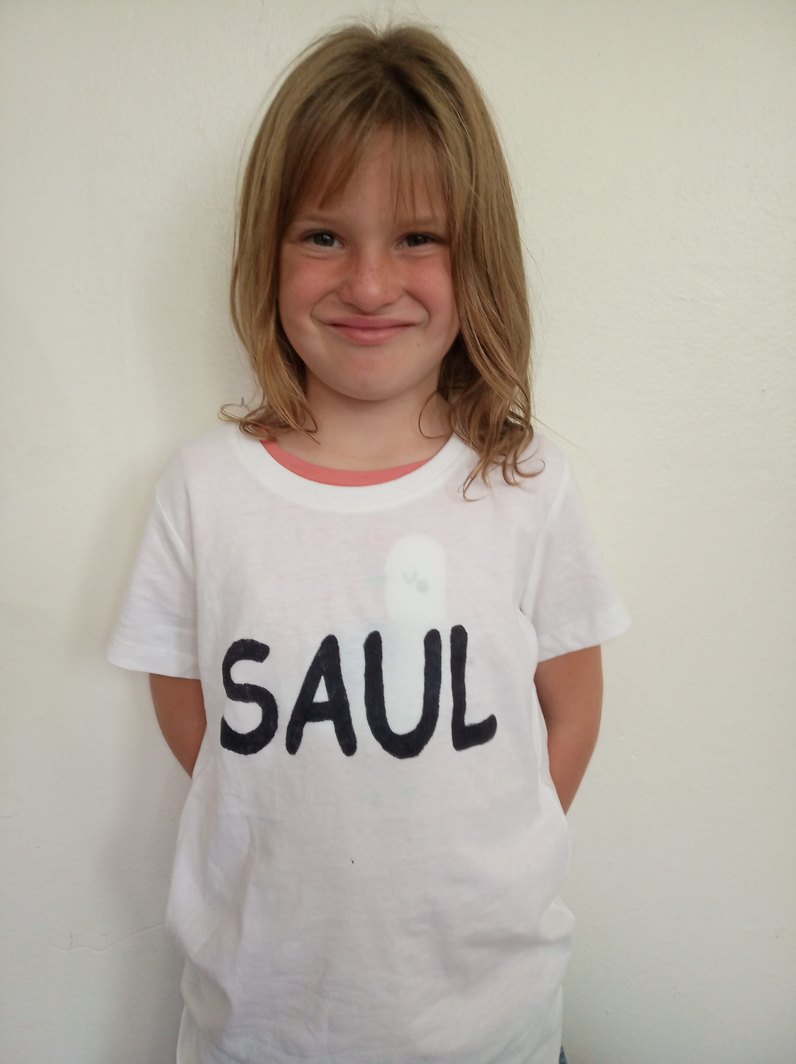
Saul
I was the first King of Israel, but pride made me fail!

Slide 6
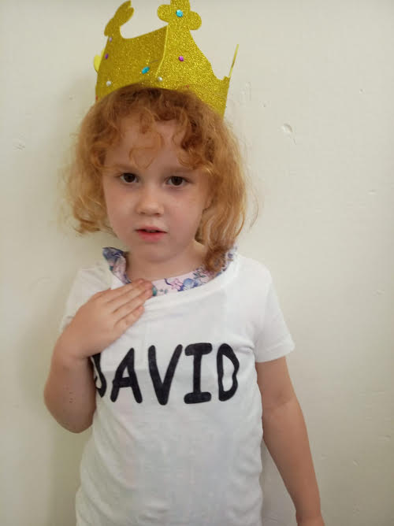
David
Right from the start I was a man after God’s own heart!

Slide 7
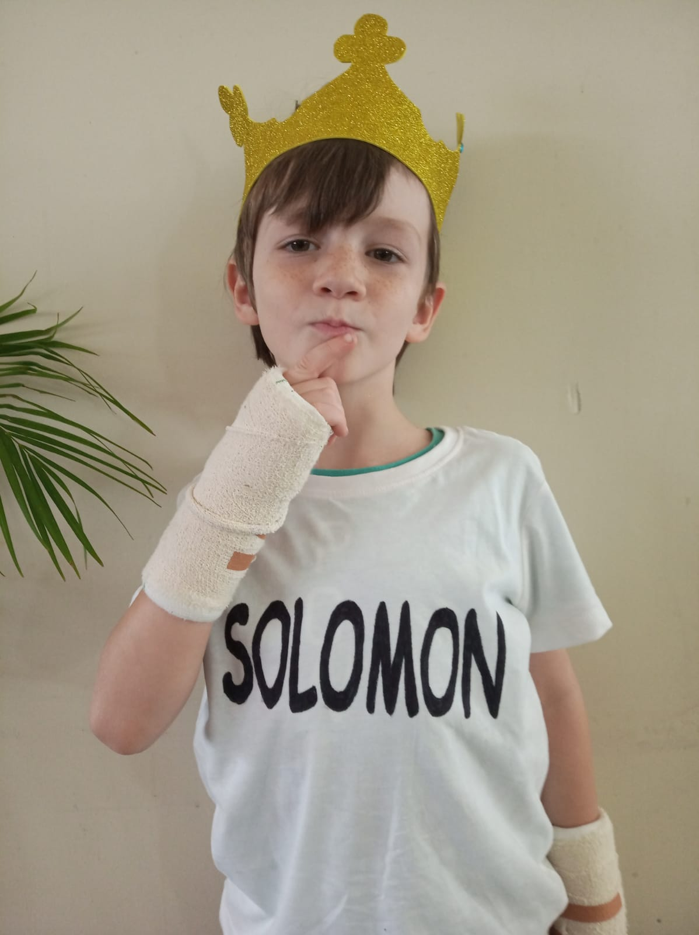
Solomon
I was very wise, except I had too many wives!

Slide 8
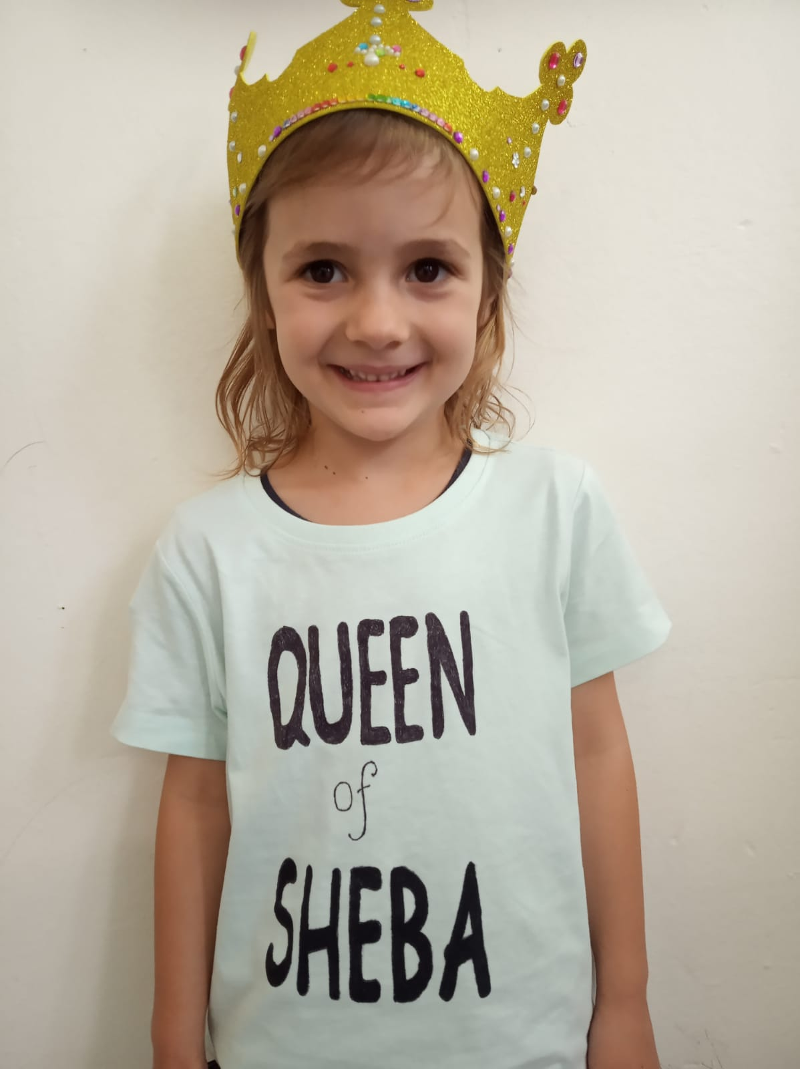
Queen of Sheba
I have questions for Solomon, Spices & Gold,
I’m checking this King is as wise as I’m told!

Slide 9
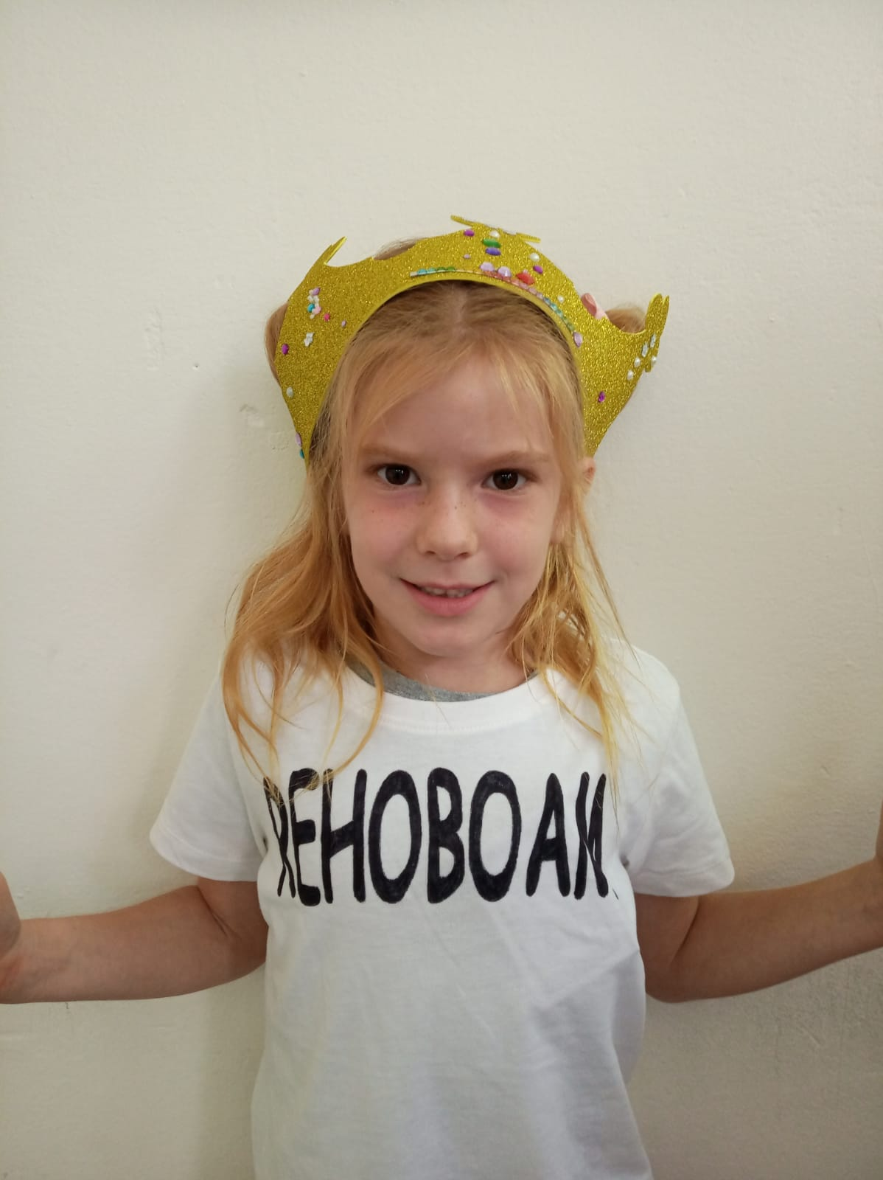
Rehoboam
I should have listened to old people’s advice, I divided the Kingdom and caused lots of strife!

Slide 10
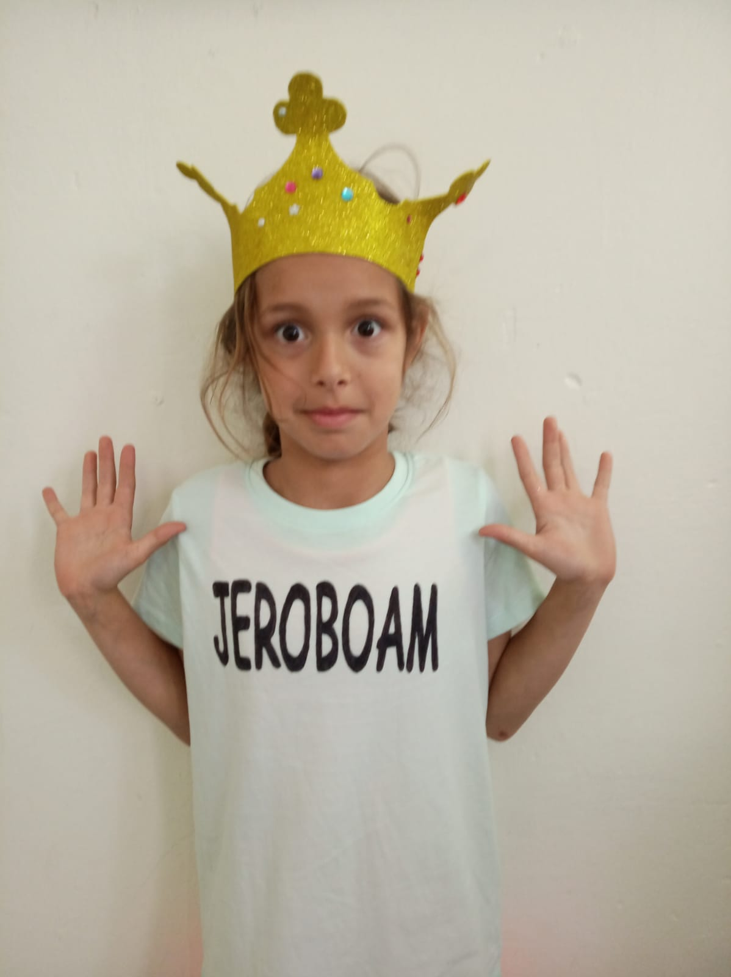
Jereboam
I took the northern tribes away, and led the people all astray

Slide 11
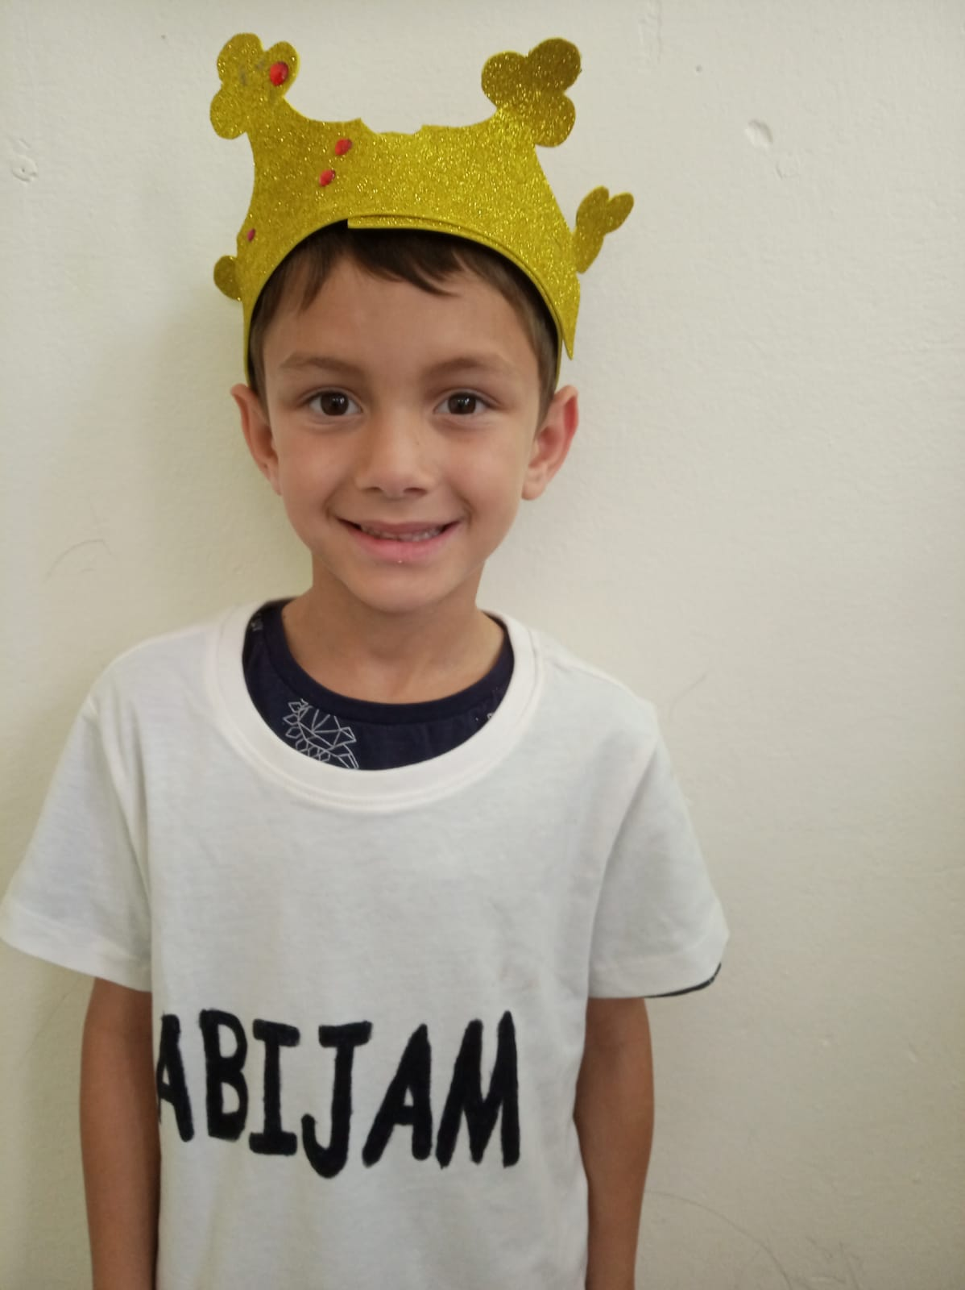
Abijam
I tried to bring Israel back, but didn’t quite have the knack

Slide 12
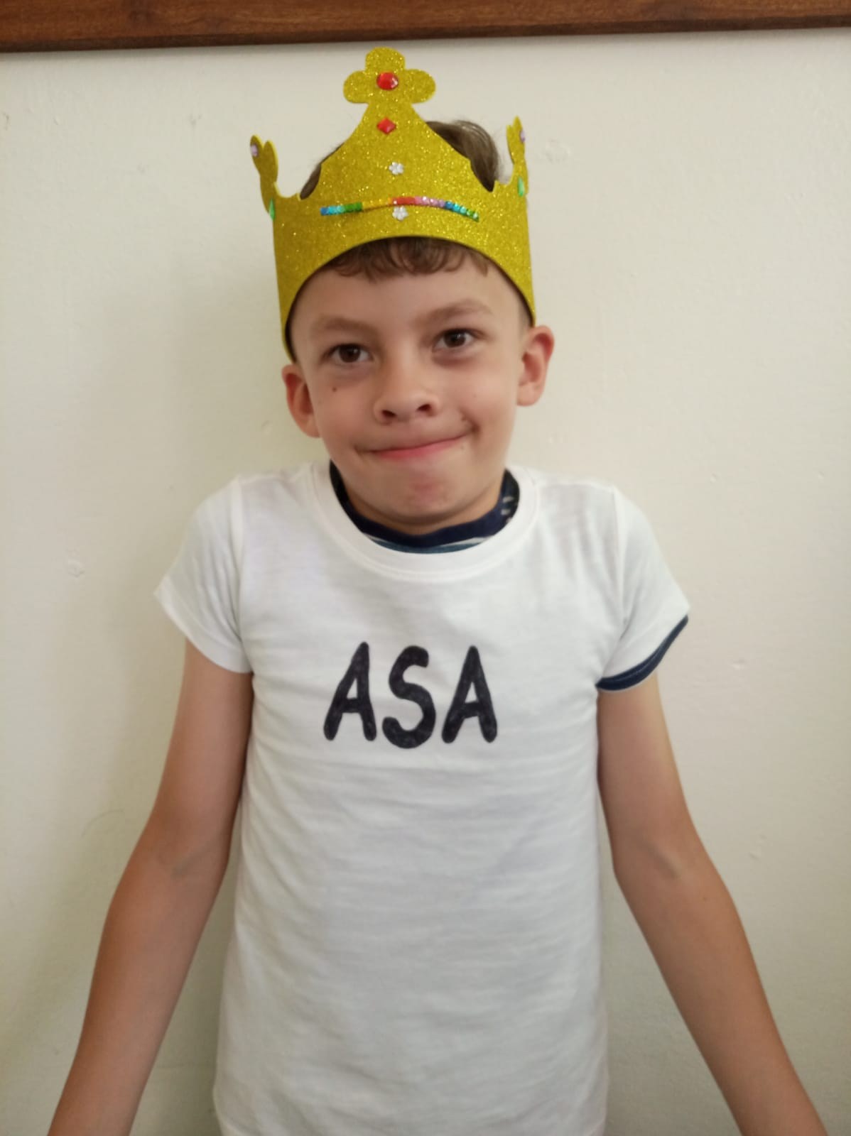
Asa
I have to stay sitting on my seat, because I have very sick feet

Slide 13
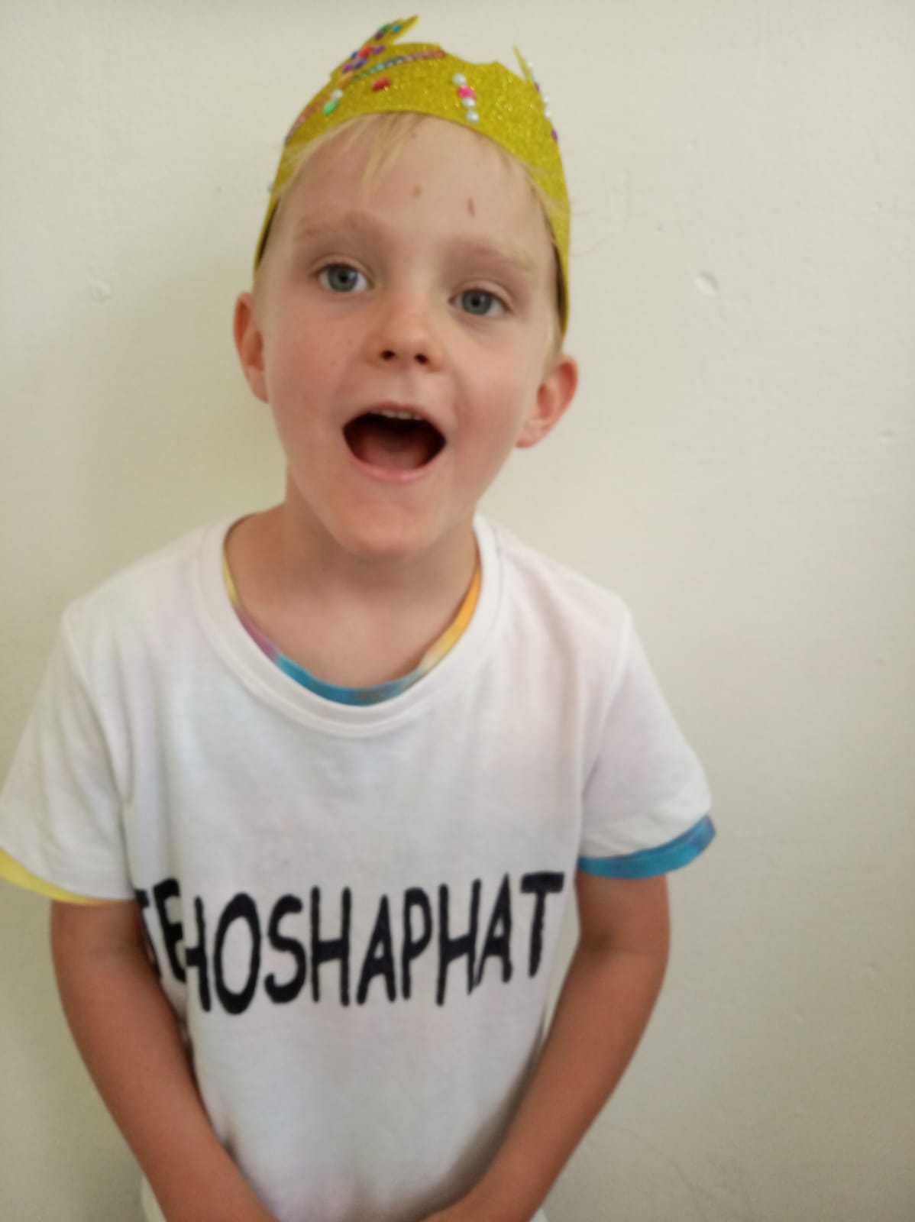
Jehoshaphat
I trusted in God always, my army won by singing praise

Slide 14
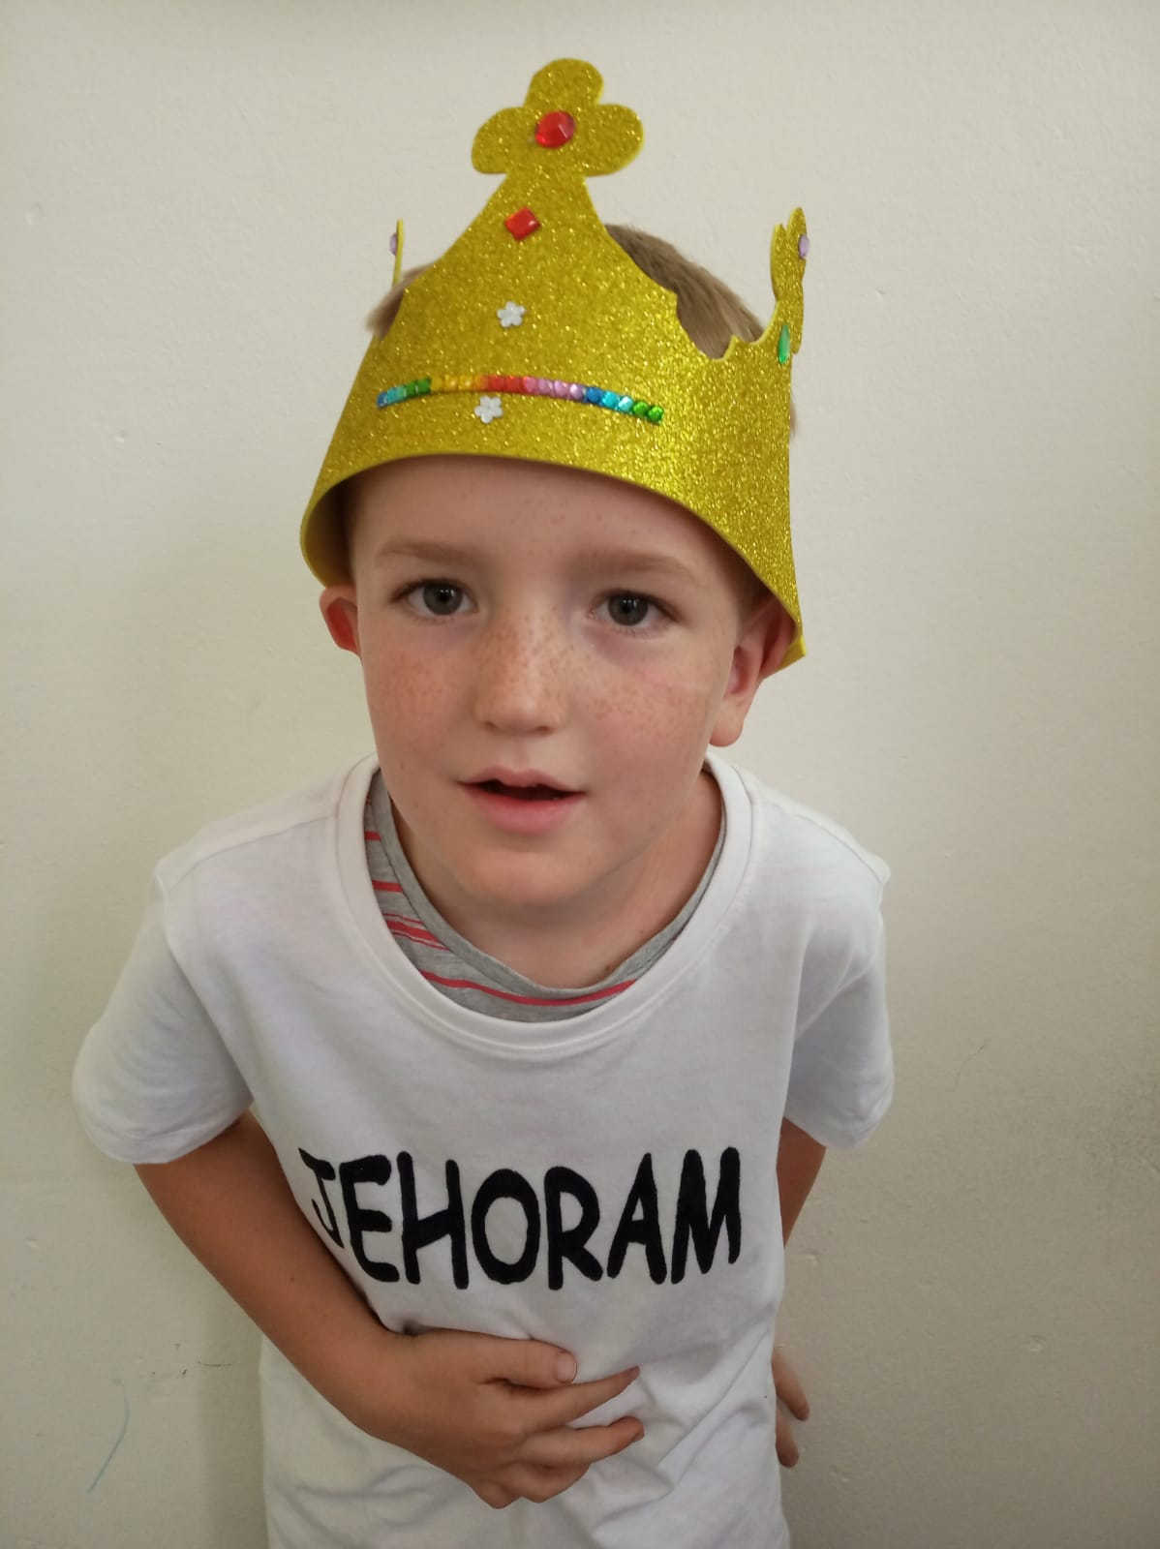
Jehoram
Athaliah was my biggest mistake, I died of a terrible tummy ache!

Slide 15
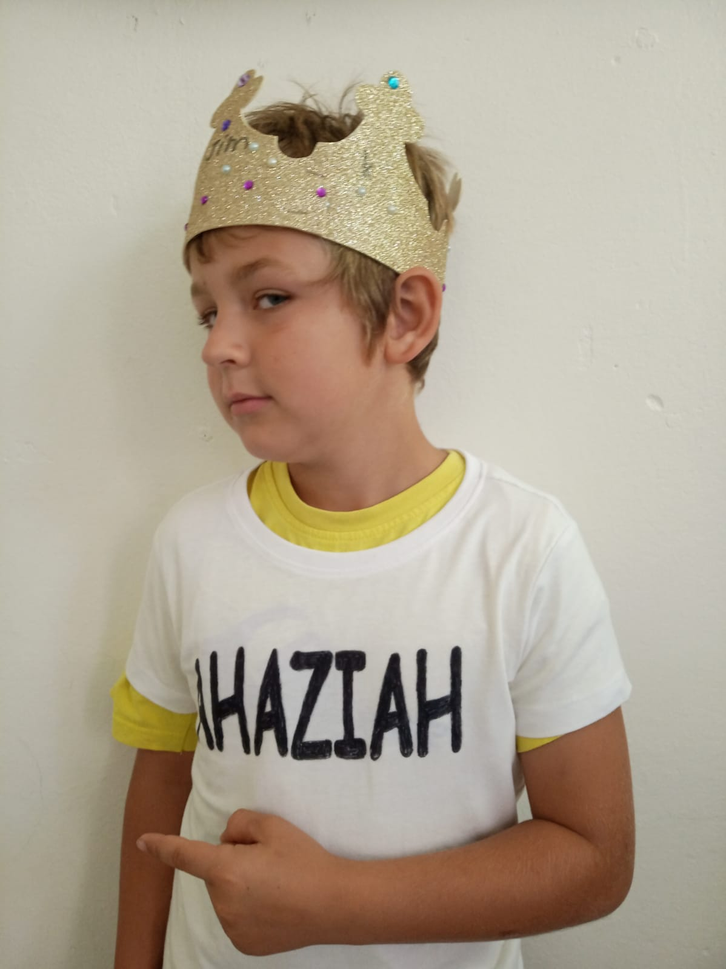
Ahaziah
Athaliah is my mum, Here comes Jehu – I have to run!

Slide 16
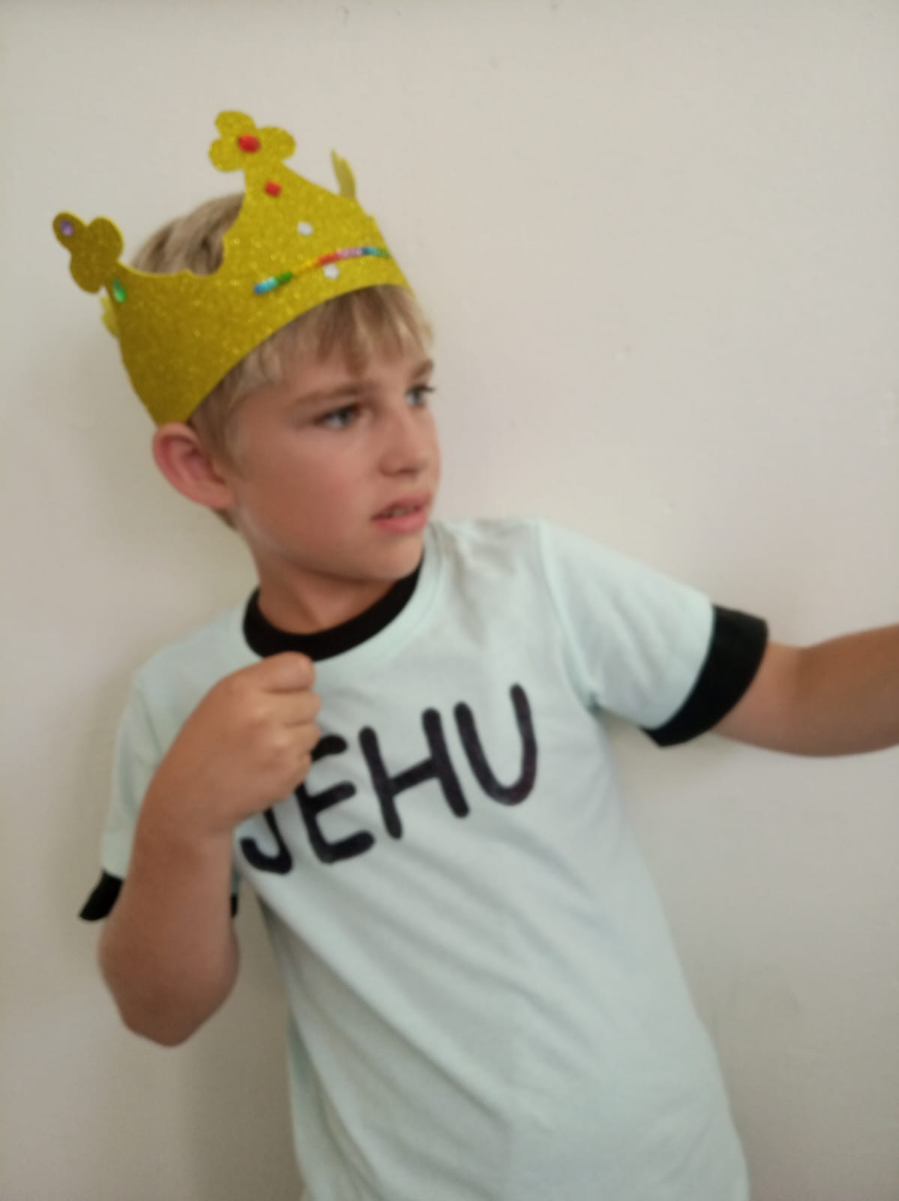
Jehu
I drive my chariot real fast!, watch out Ahaziah, you will not last!

Slide 17
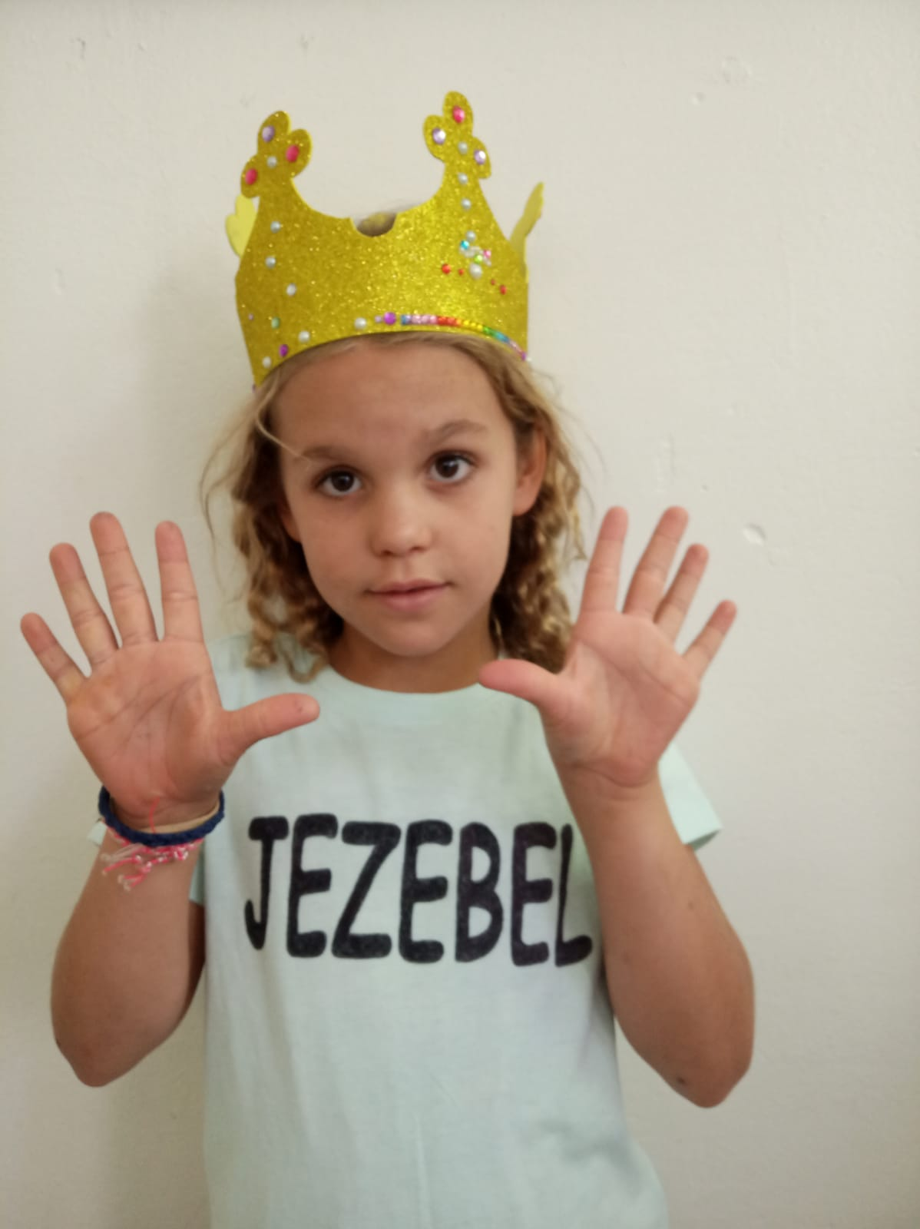
Jezebel
My head, my hands and my feet, were so bad the dogs refused to eat!

Slide 18
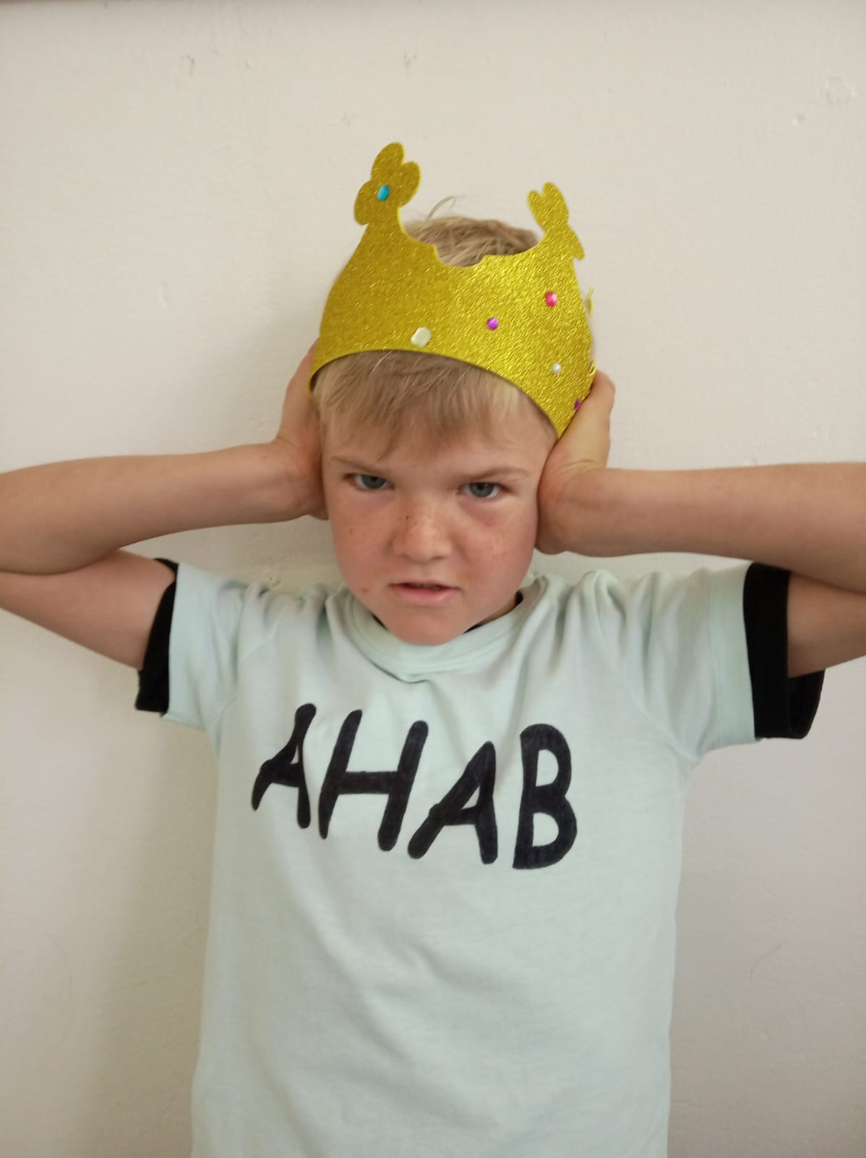
Ahab
I married a very bad wife, she caused me so much strife!!

Slide 19
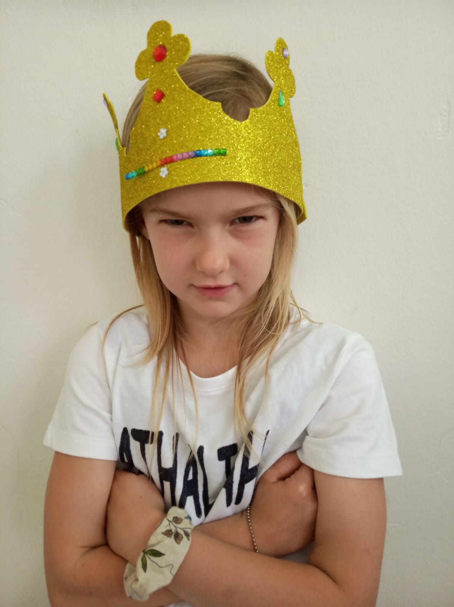
Athaliah
I was the nastiest grandma you could meet; cried out “Treason”, but I was beat!

Slide 20
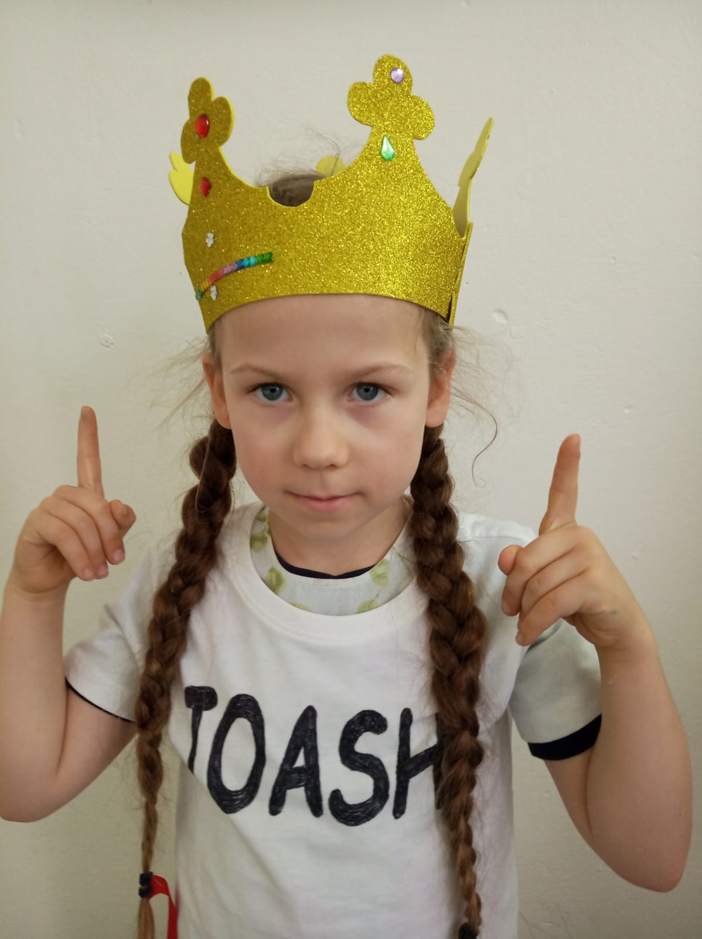
Joash
I became the King at 7; and worshipped right the God of Heaven

Slide 21
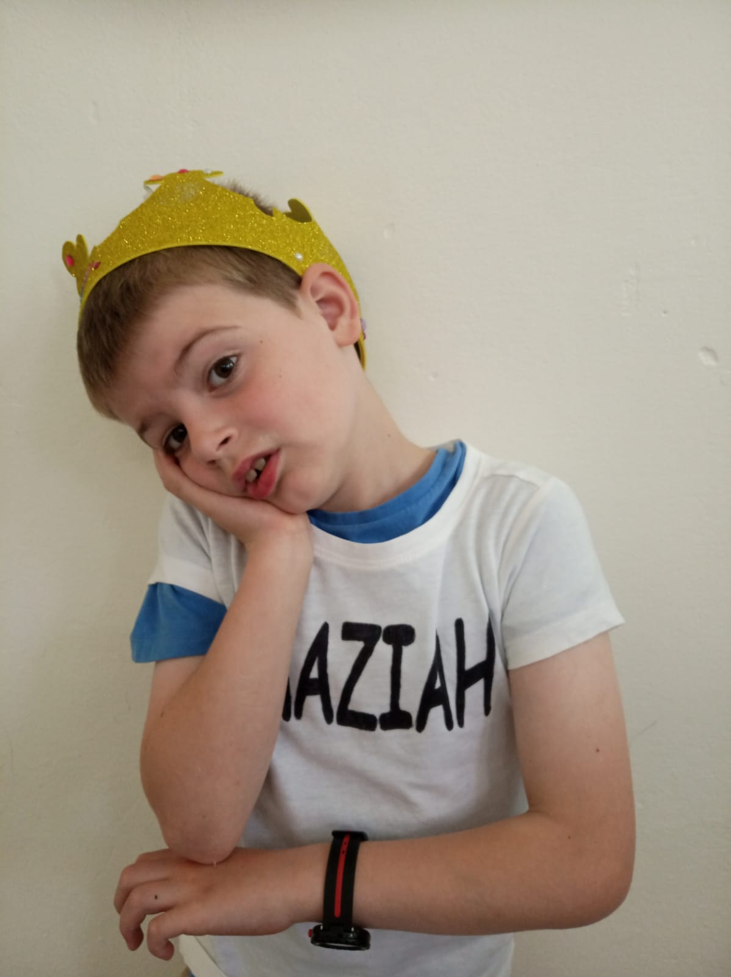
Amaziah
I punished the men that killed my dad; but in the end I turned out bad!

Slide 22
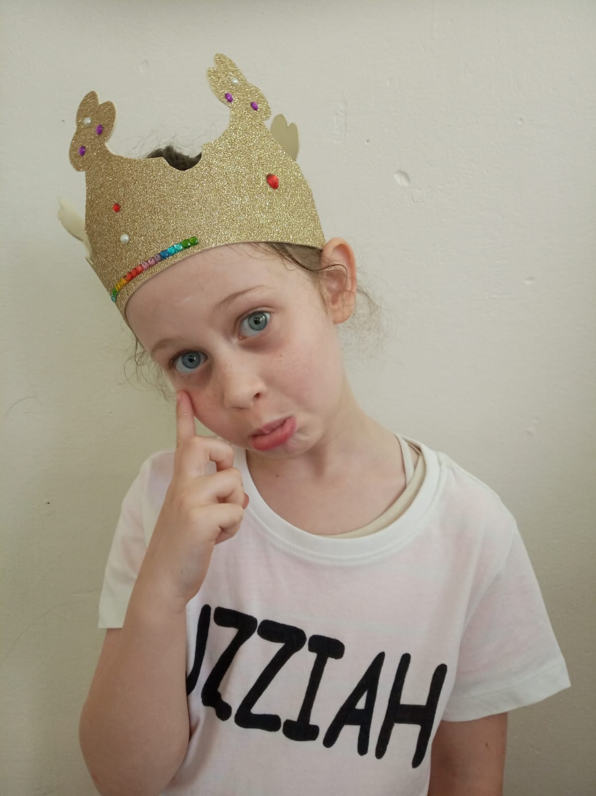
Uzziah
I went into the temple, which was bad; and was punished with leprosy - so sad!

Slide 23
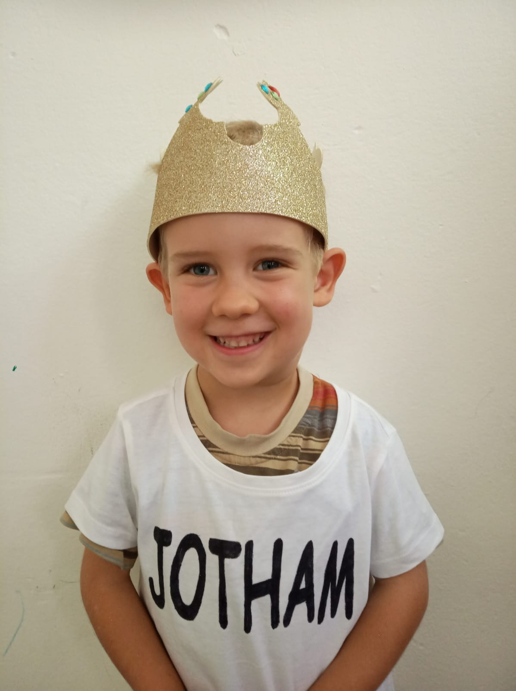
Jotham
My dad stayed away with his leprous skin; for 16 years I ruled instead of him

Slide 24
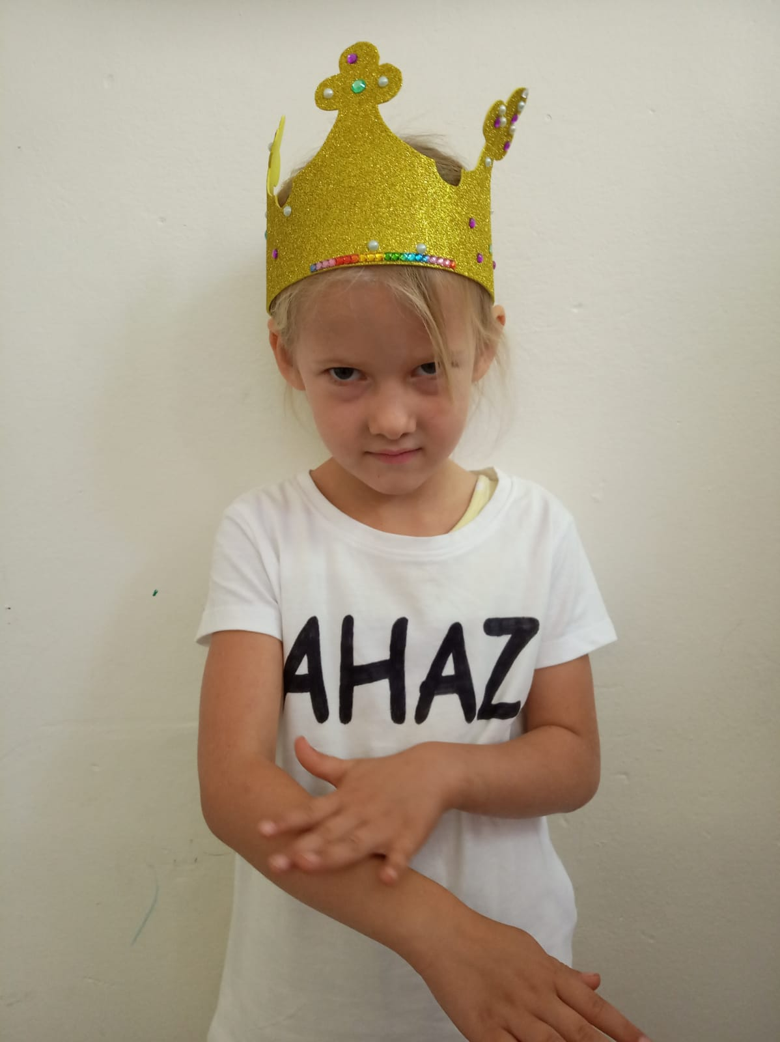
Ahaz
Worshipping idols was my thing; I offered my son and burnt his skin

Slide 25
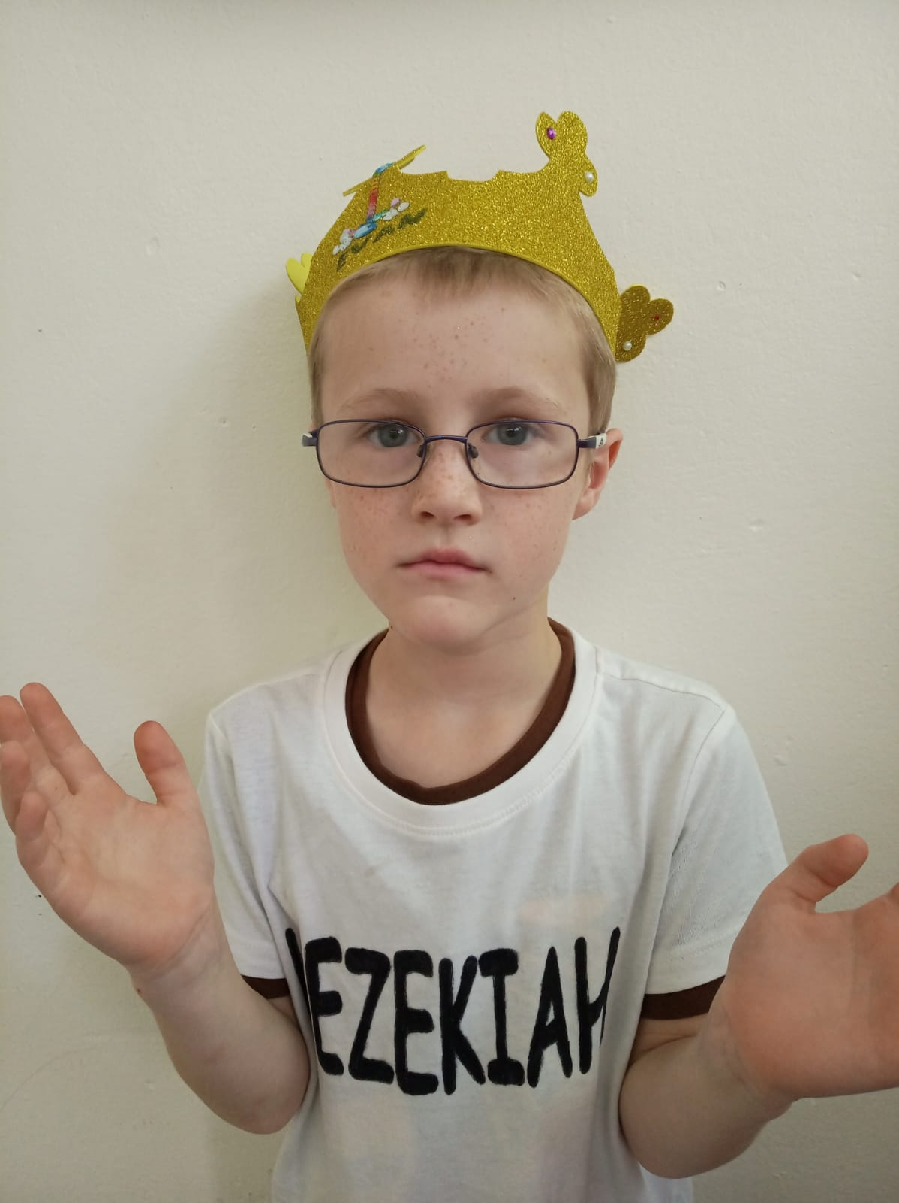
Hezekiah
I called all Israel to keep Passover with me; I served God in truth in his Sanctuary

Slide 26
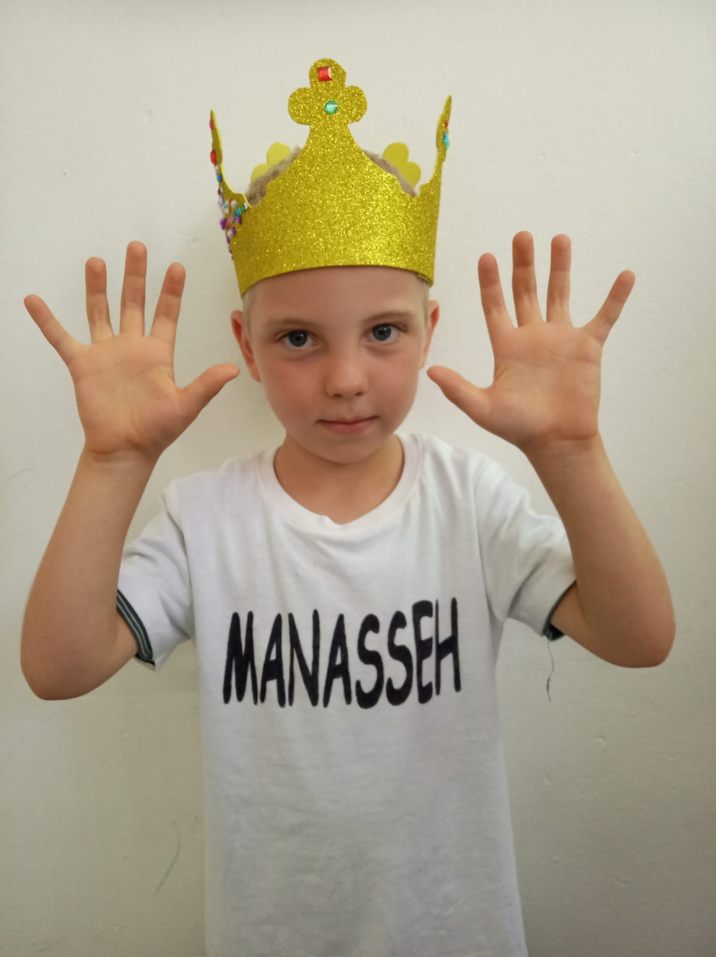
Manasseh
I wickedly reigned for 55 years; captivity brought me to repentant tears!

Slide 27
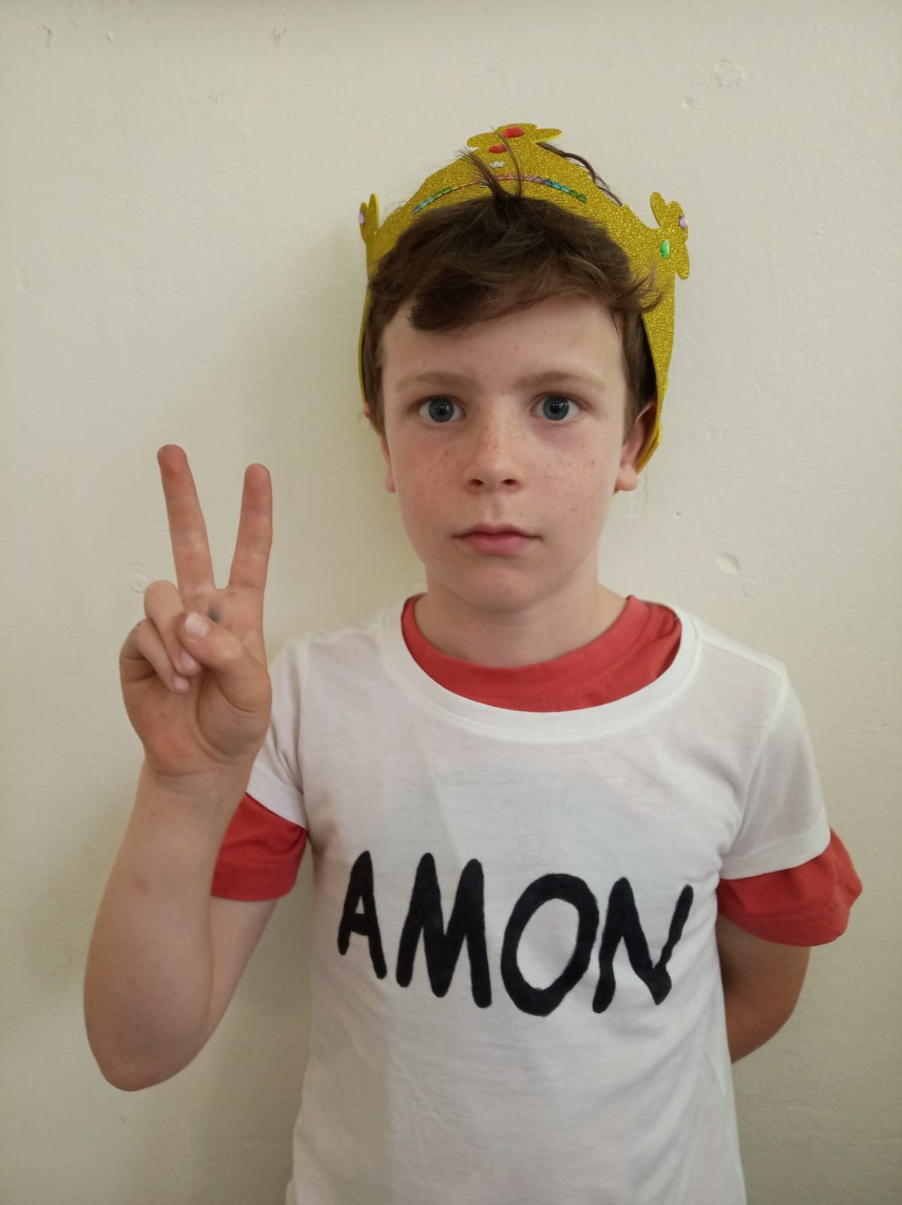
Amon
I worshipped idols of wood and stone; reigned 2 years on Judah’s throne

Slide 28
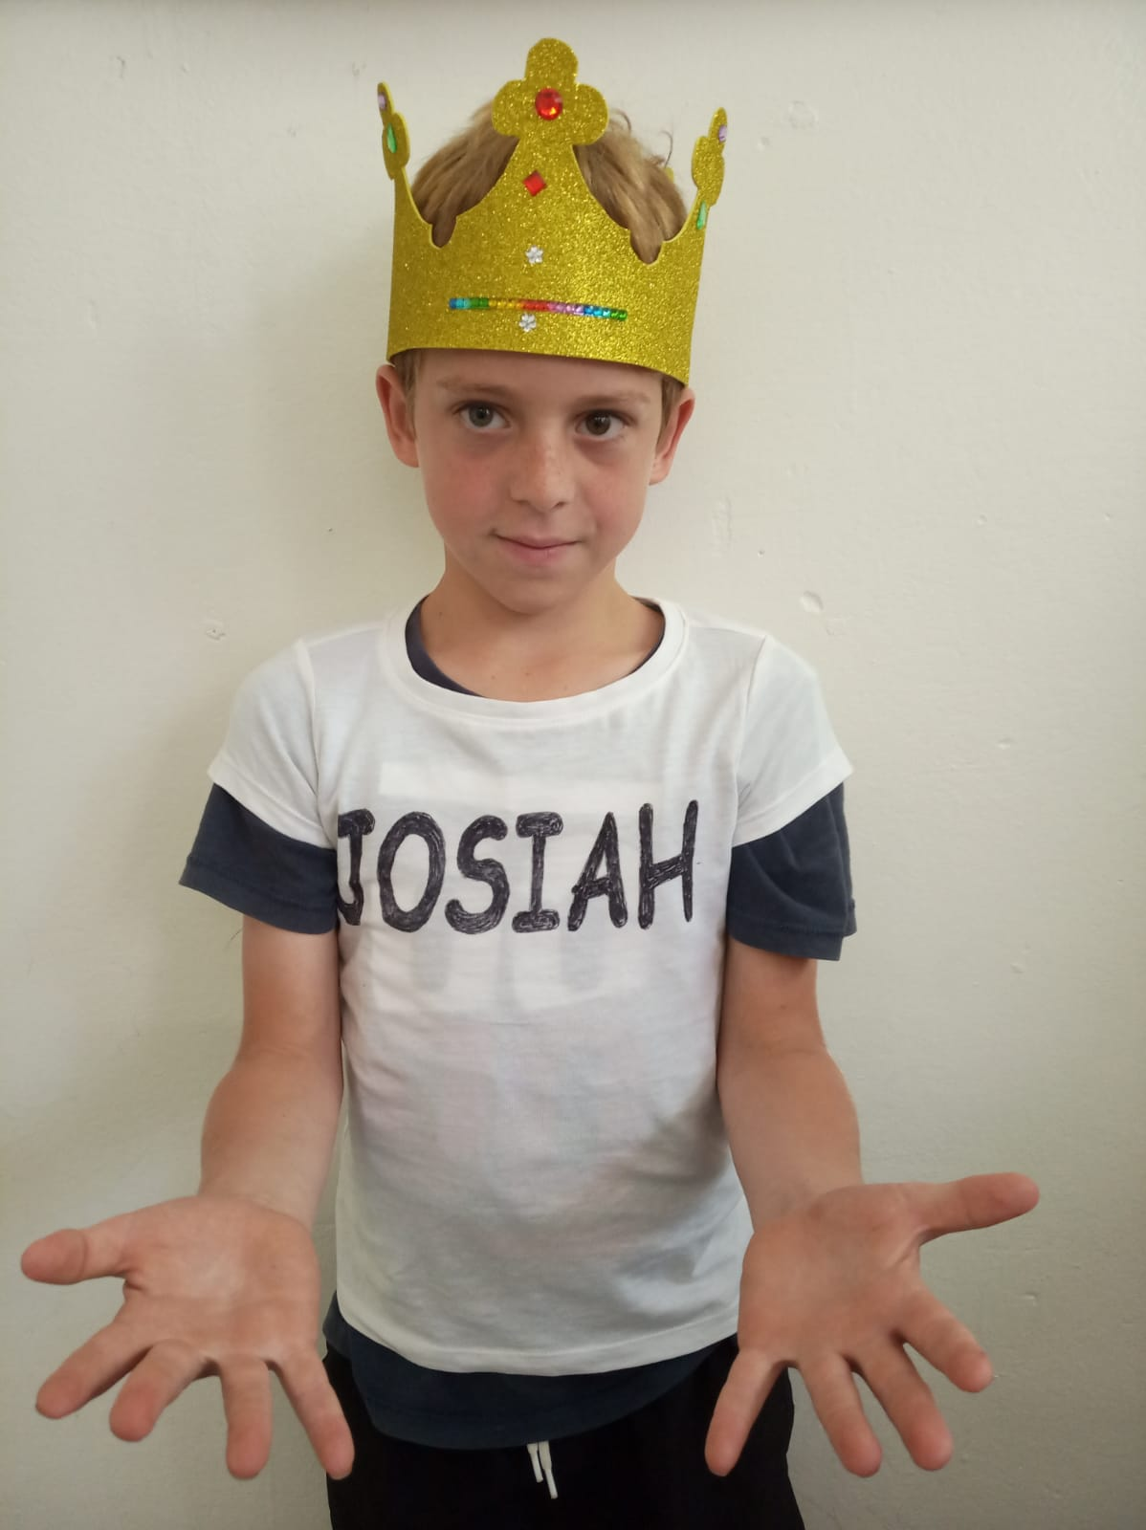
Josiah
The book of the Law I found; tried really hard turning Judah around

Slide 29
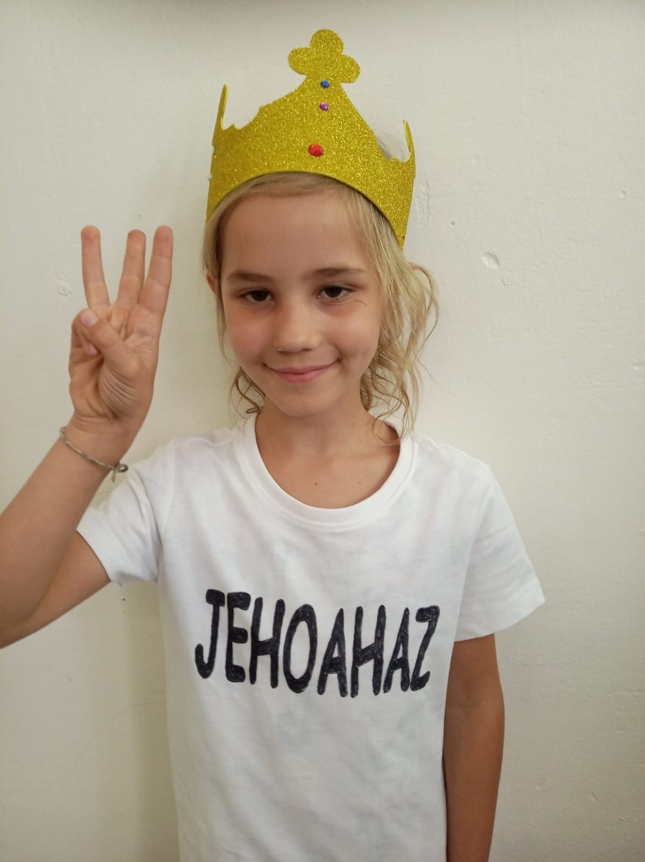
Jehoahaz
I reigned 3 months and then was shown, by Pharaoh I couldn’t have the throne

Slide 30
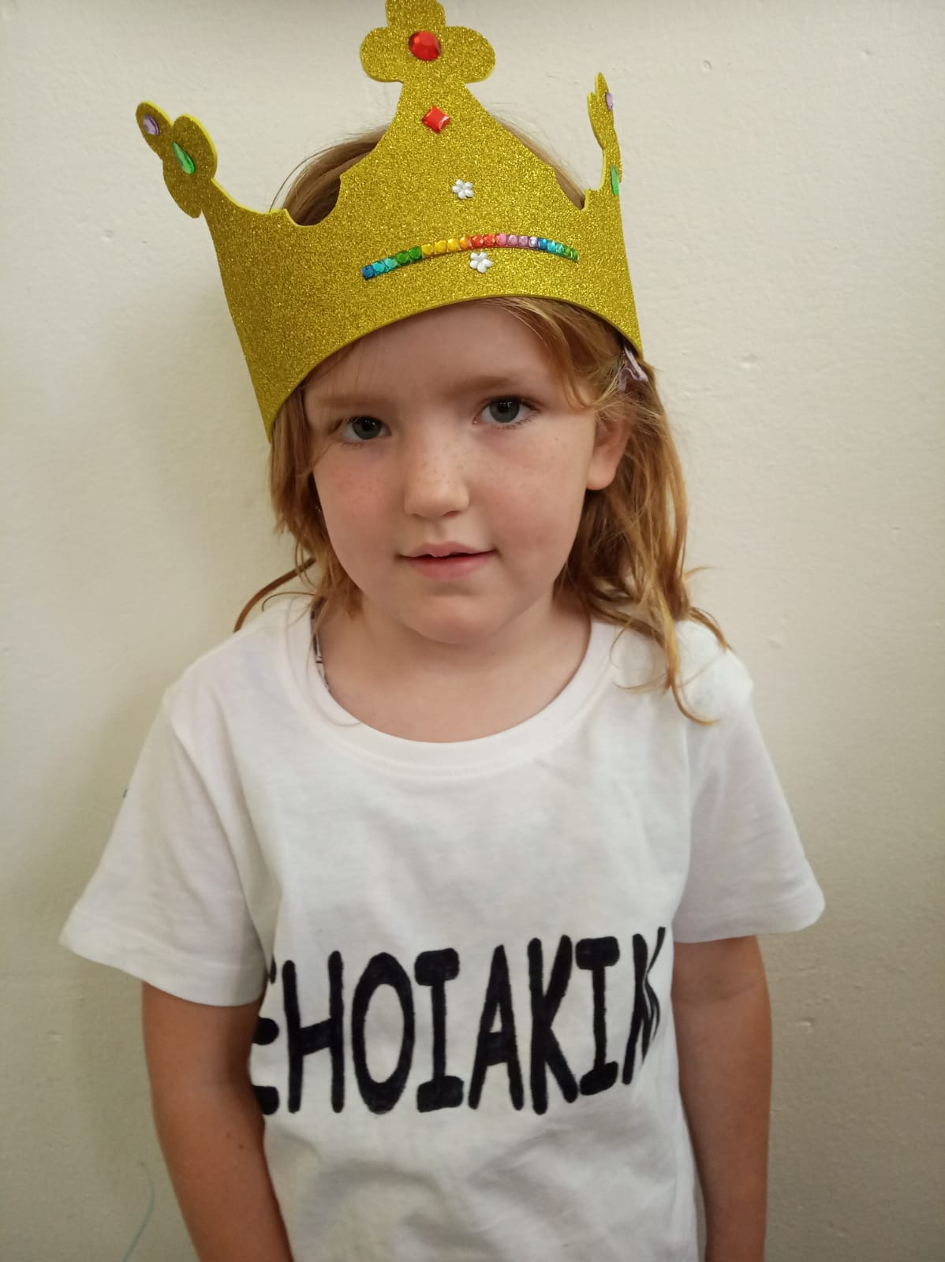
Jehoiakim
I was a wicked King for 11 years; I taxed the people and drove them to tears!

Slide 31
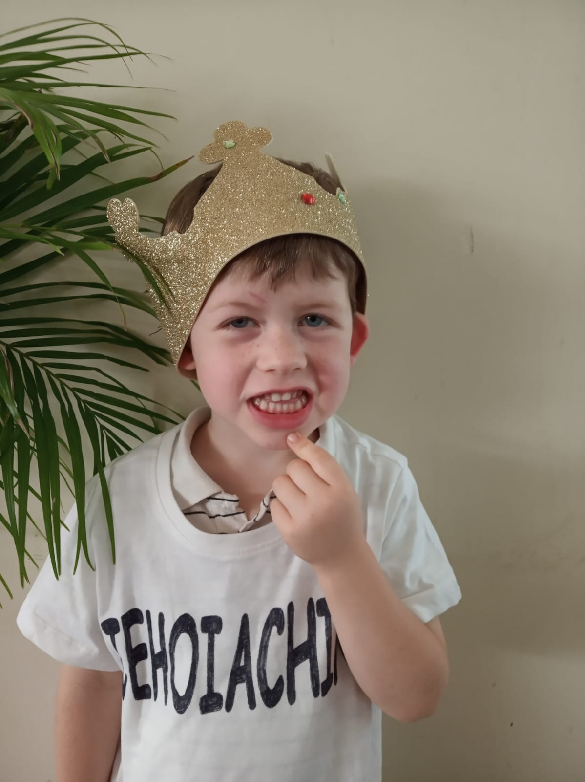
Jehoiachin
After 3 months I was taken away, to Babylon where I had to stay!

Slide 32
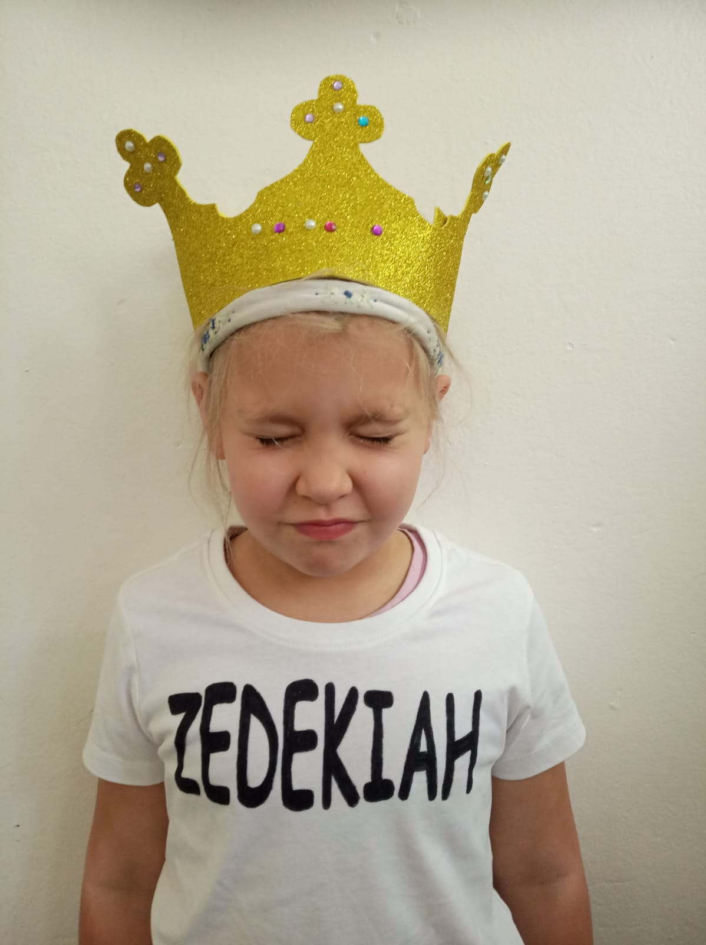
Zedekiah
I’m the last King of Judah, there will be no more; Till the promised son of David, will rule for sure

Slide 33
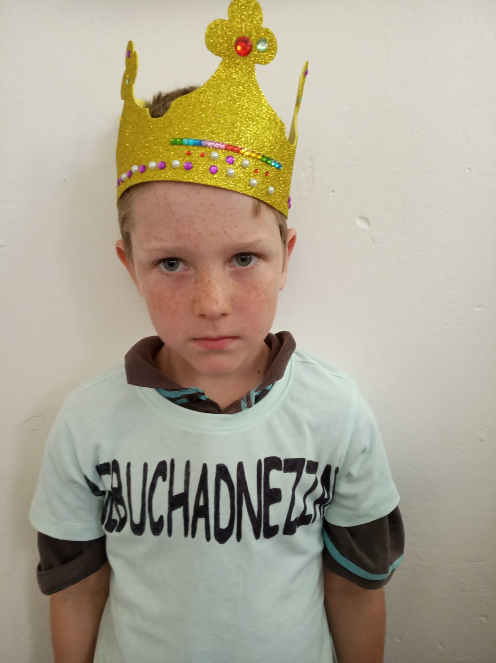
Nebuchanezzar
I put out Zedekiah’s eyes; Jerusalem now in darkness lies!

Slide 34
Song – “Rulers of Judah” Audience Join In
Now Judah’s rulers numbered twenty, only eight were good
The Kingdom was divided, and then only Judah stood
And some ruled with their father, and some waited ‘til their death
It all got started, with Solomon’s dying breath.

Slide 35
First Rehoboam, Abijah, Asa, then Jehoshaphat
Jehoram, Ahaziah, Athaliah and Joash
Then Amaziah, Azariah, Jotham and Ahaz
And then Hezekiah turned Judah back to God.

Slide 36
Manasseh, Amon, and Josiah, then Jehoahaz
Jehoiakim, Jehoiachin, and Zedekiah last
And then who was the only ruler that all of them would know?
It was King Nebuchadnezzar, to Bab’lon they did go.

Slide 37
Now one last King that’s still to reign is David’s promised Son
He’ll come again to rule the earth, so Yahweh’s will is done
The King of Kings and Lord of Lords will rule so perfectly
He’s the King that we are waiting now to see.

Slide 38
The End

